Slide 1
Update: Tacoma PM_{2.5} Attainment
May 10, 2013
Andrew Green

Slide 2
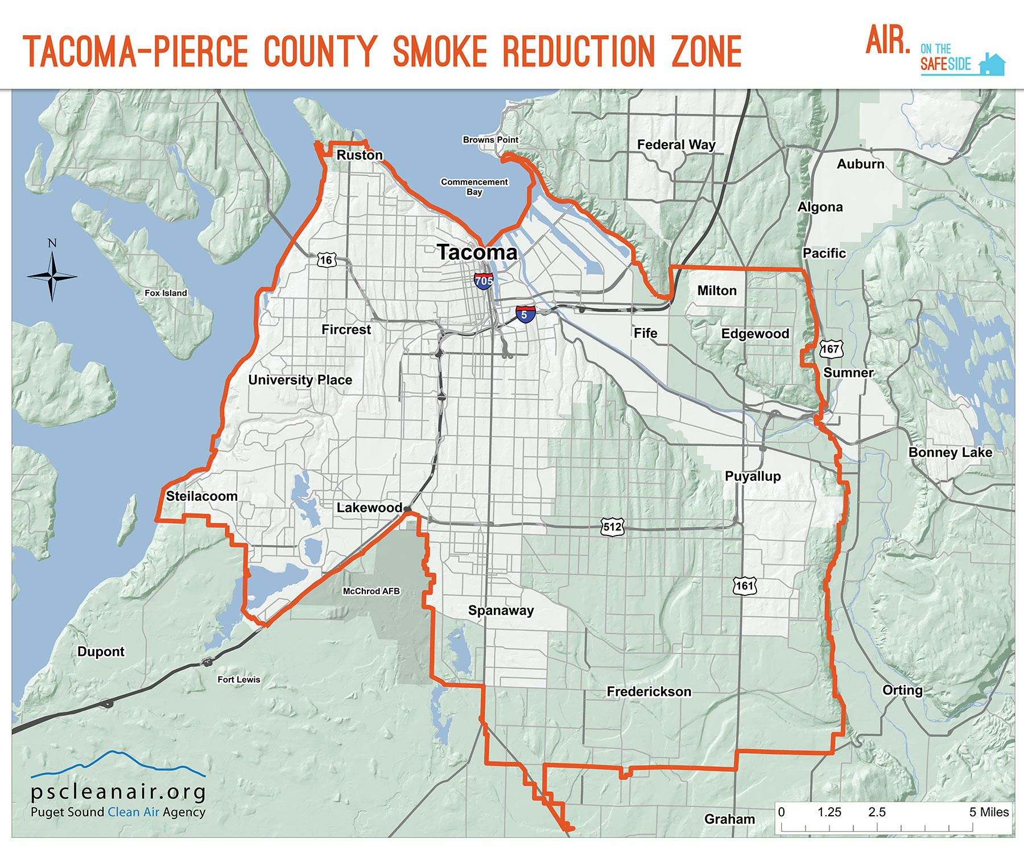

Slide 3
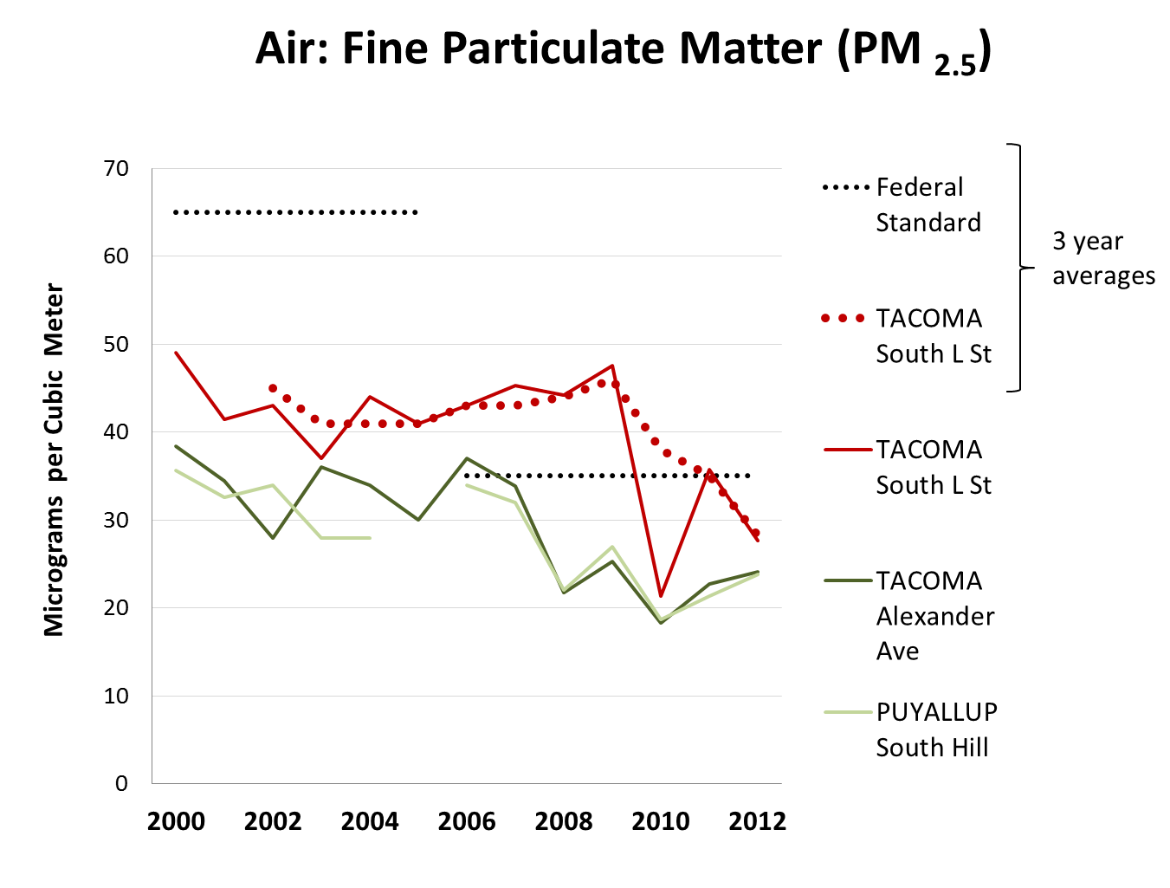

Slide 5
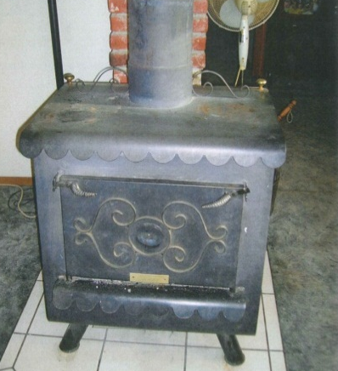
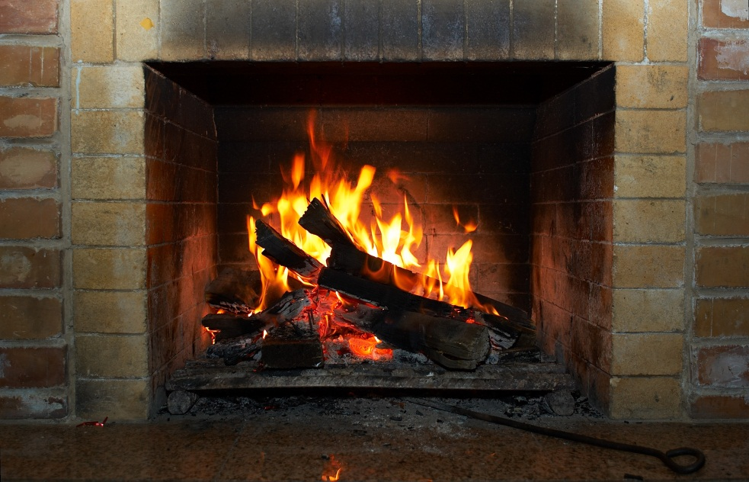
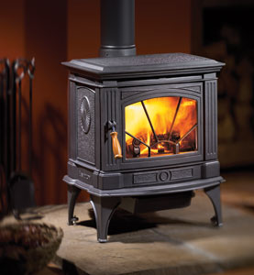
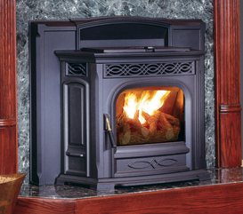
What are “wood burning devices”?

Slide 6
Number of Devices
2008 | Households w/ device | Households that use device
Fireplaces | 30,900 | 21,200
Uncertified inserts and stoves | 24,200 | 21,200
Certified inserts and stoves | 20,200 | 17,200
Pellet stoves | 3,900 | 2,100
Total | 79,200 | 61,700

Slide 7
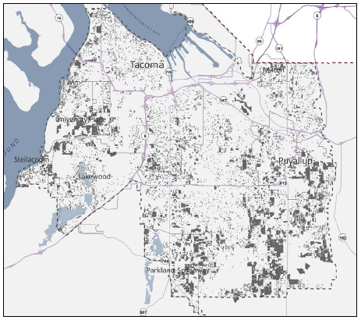
Location of wood stoves in Smoke Reduction Zone

Slide 8
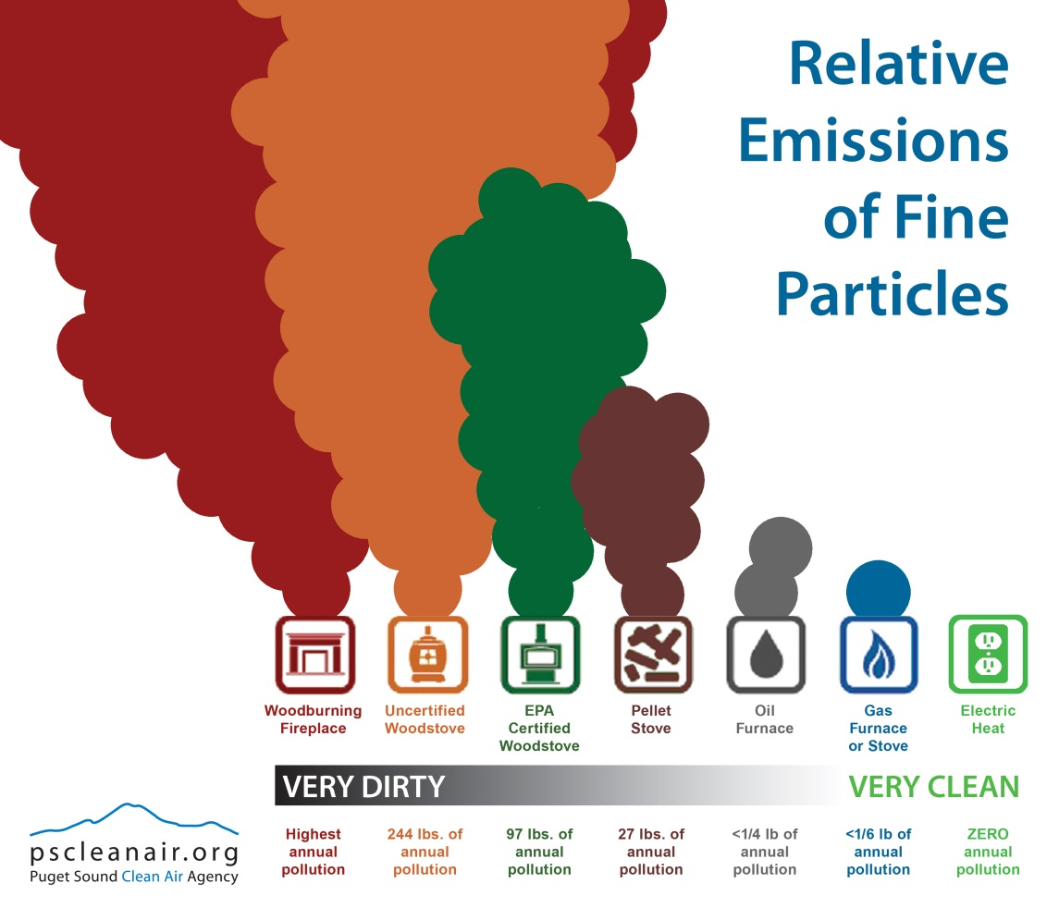

Slide 9
PM2.5 Wood Smoke Emissions

Slide 10
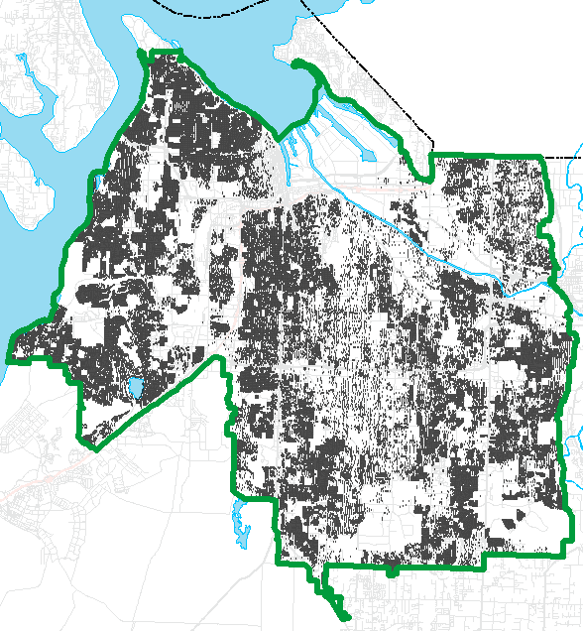
Stakeholder Task Force Solutions
Enhanced enforcement of burn bans
Removal of old “uncertified” wood stoves and inserts
September 30, 2015
Public education and outreach
Support planned reductions from other sources
E.g. federal engine & fuel standards

Slide 11
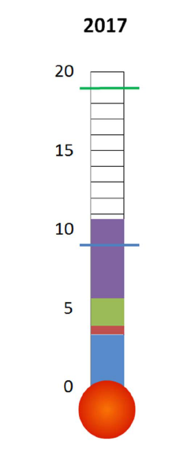
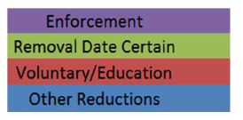
Reduction from each strategy in micrograms per cubic meter (µg/m³)

Slide 12
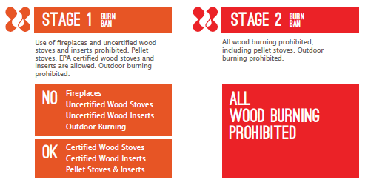
Burn Bans

Slide 13
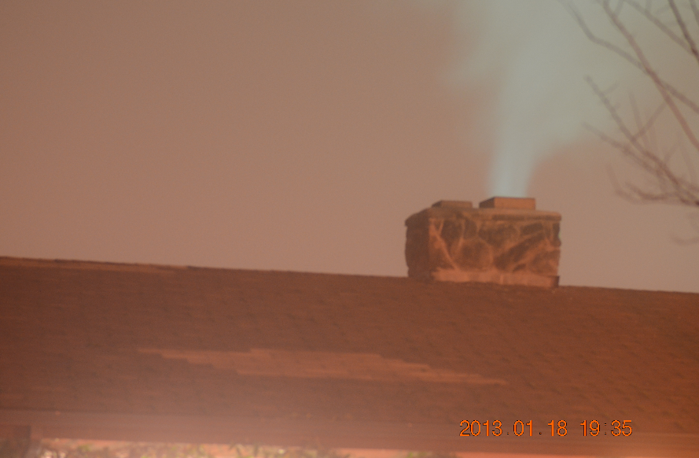
Enhanced Burn Ban Enforcement
Lower Stage 1 forecast trigger
Significant increase in patrolling staff
From ~8 to 77
Interlocal agreements
1,500 NOVs
Nighttime enforcement
Most burning happens in evenings
Long exposure photography
Civil penalty structure
Initial penalty is $1,000
Can “get to zero” on first offense, if take action
e.g. sign up for text alerts, wood stove replacement/removal program
No other adequate source of heat exemption process

Slide 15
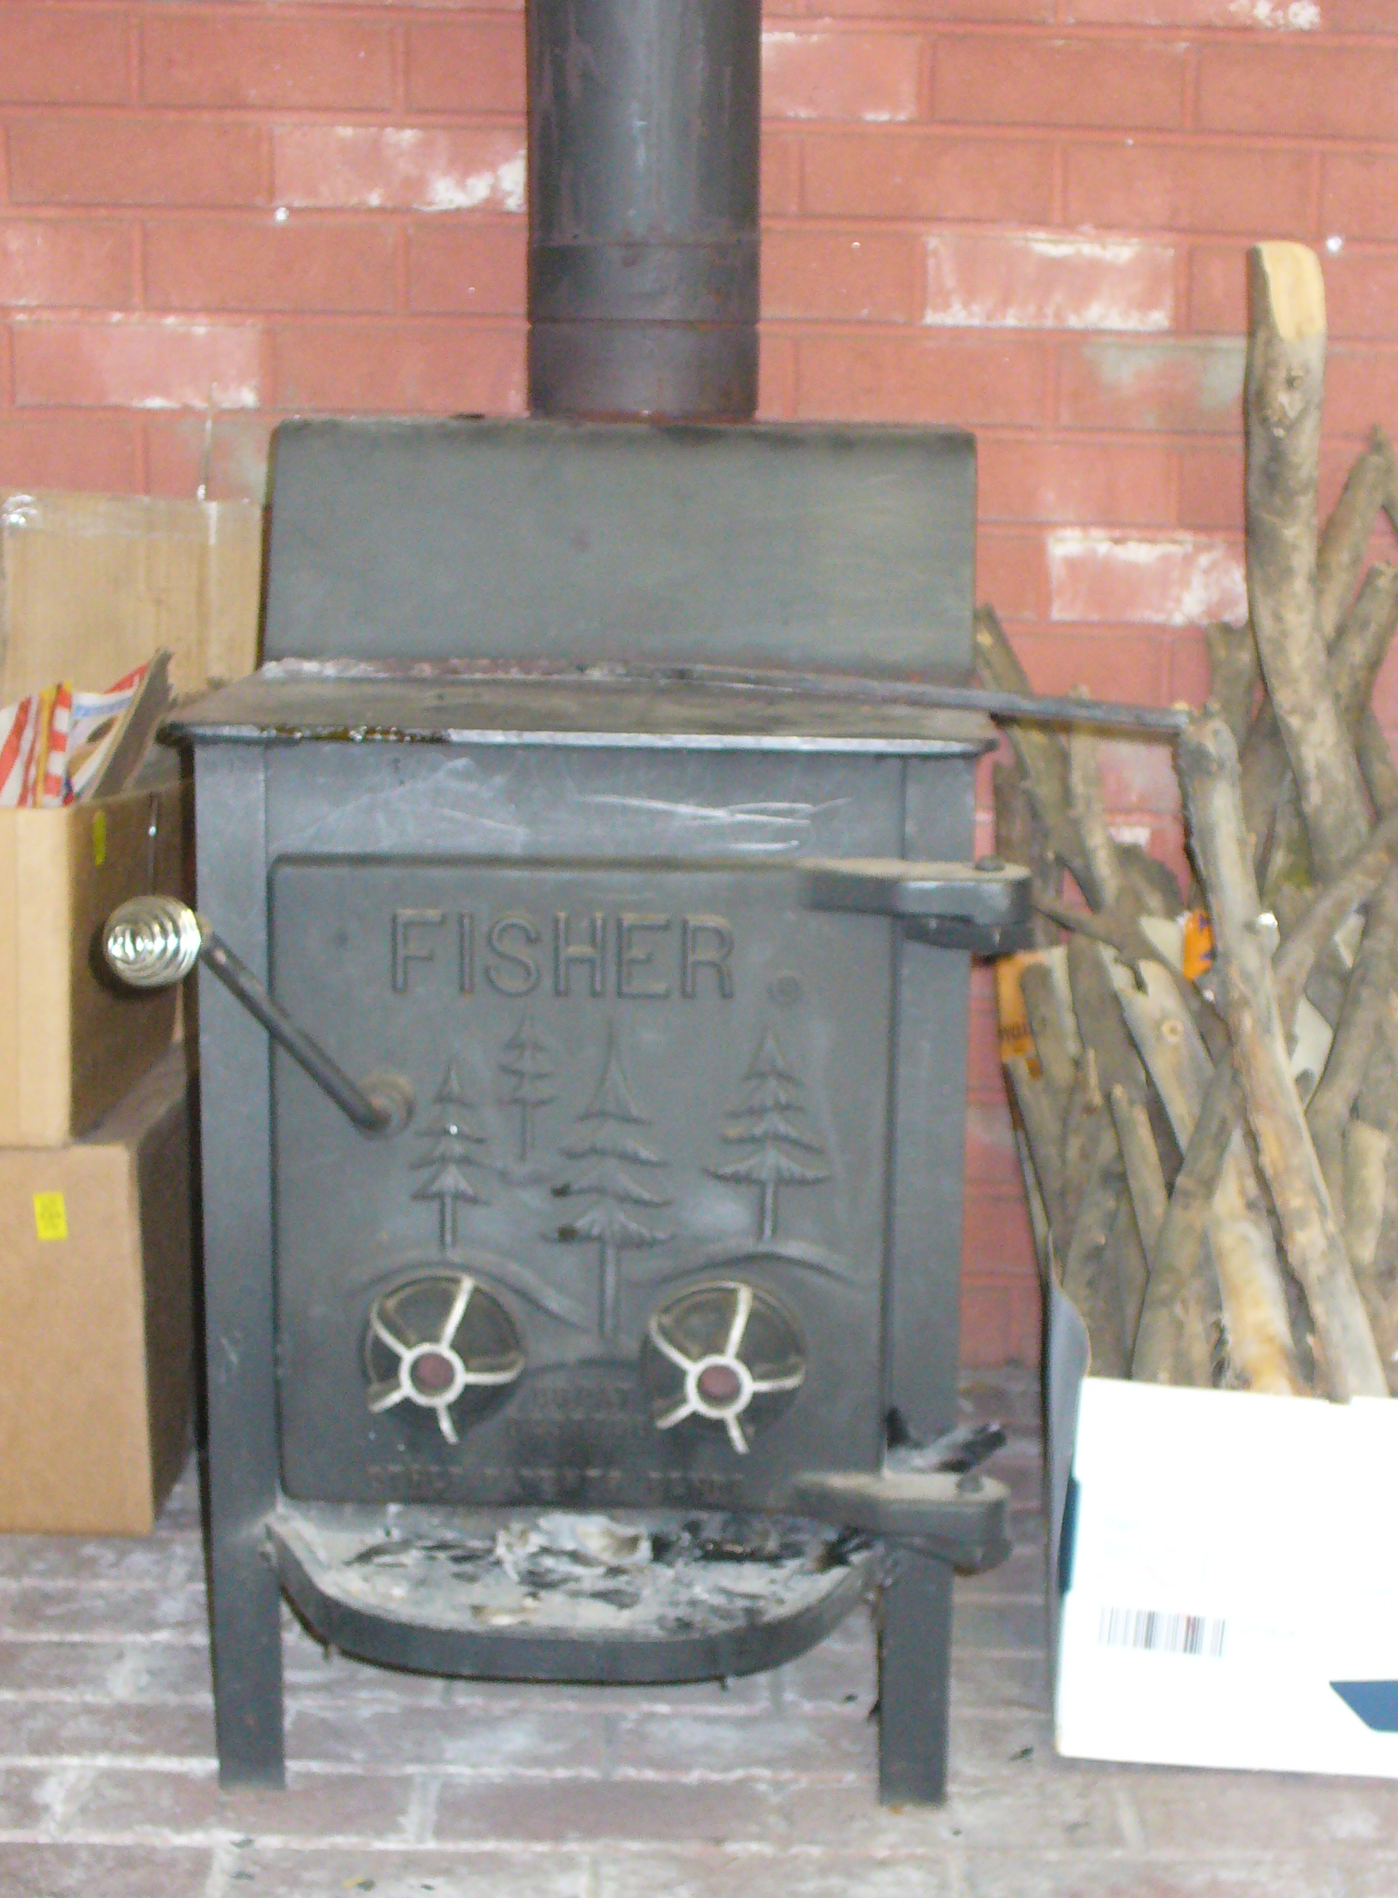
Wood stove program
Three components:
Low-income replacement (fully funded)
“Early adopter” replacement incentives
Removal (buy-back)
Fireplace pilot

Slide 16
Wood stove program (cont.)
Low-Income
Free replacement (allows certified wood)
157 to date (Apr. 30)
80 chose wood, 31 heat pump, 23 gas, 18 pellet, 4 propane
Replacement Incentives
90 to date
8 “grand prize” free
88 x $1500/$1000 off new device (no wood)
Drawings Nov. 30 & Mar. 12
Buy-back / Recycling Reward
20 x $200 in-home removals to date
128 x $350 drop-offs to date

Slide 17
Public outreach
Public outreach a core value and essential to success
Three primary messages
Burn ban enforcement is increasing. Avoid possible fines.
Assistance is available to help you “leave your old flame behind.”
Whenever you burn, practice cleaner burning techniques.
Major public communications campaign
Multi-media approach
November 2012-March 2013
www.airsafepiercecounty.org

Slide 18
Campaign components
Outdoor advertising
Print advertising
Web
www.airsafepiercecounty.org
Online advertising
Printed materials (e.g., posters, flyers, fast fact cards)
Targeted direct mail
Regular press
Social media (Twitter, Facebook, YouTube)
Coordinated outreach through local partners

Slide 20
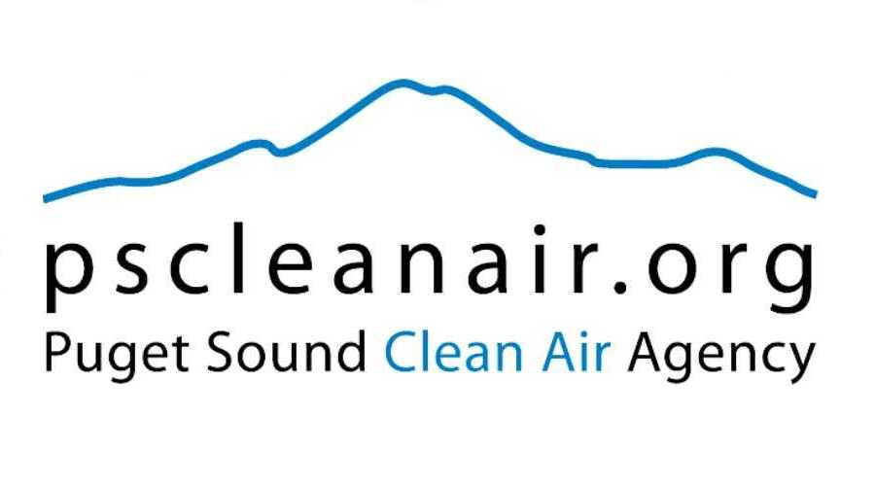
Questions?
Andrew Green
Puget Sound Clean Air Agency
206-689-4053
AndrewG@pscleanair.org

