Slide 1
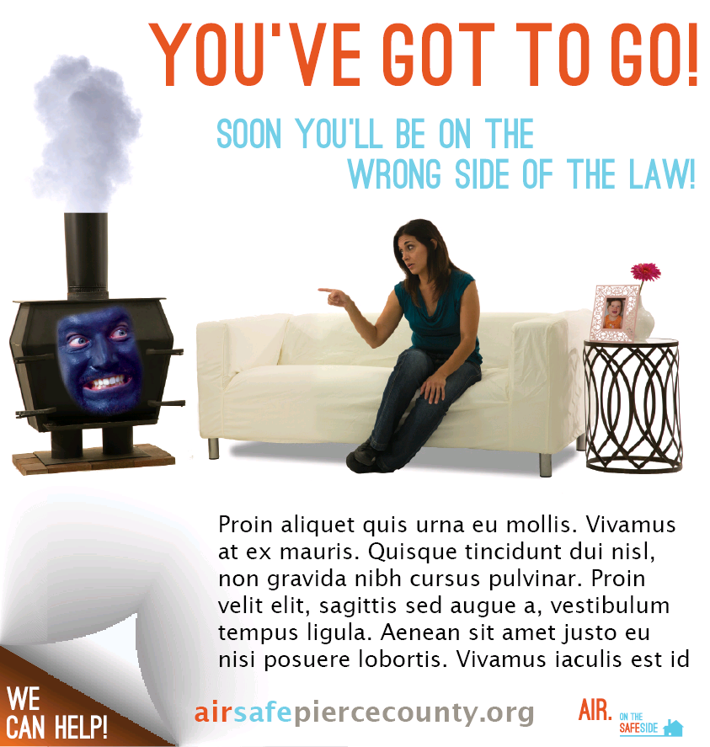
AirSafe ISOY Campaign
Display Ad
Tacoma News Tribune
2 col W x 4 in H
Joanne/Richard/Kit
Oct 20, 2014

Slide 2
AirSafe ISOY Campaign
Display Ad
Tacoma News Tribune
3 col W x 4 in H
Joanne/Richard/Kit
Oct 20, 2014

