Slide 1
24,000 Uncertified Devices
I think we’re going to need a bigger carrot

Slide 2
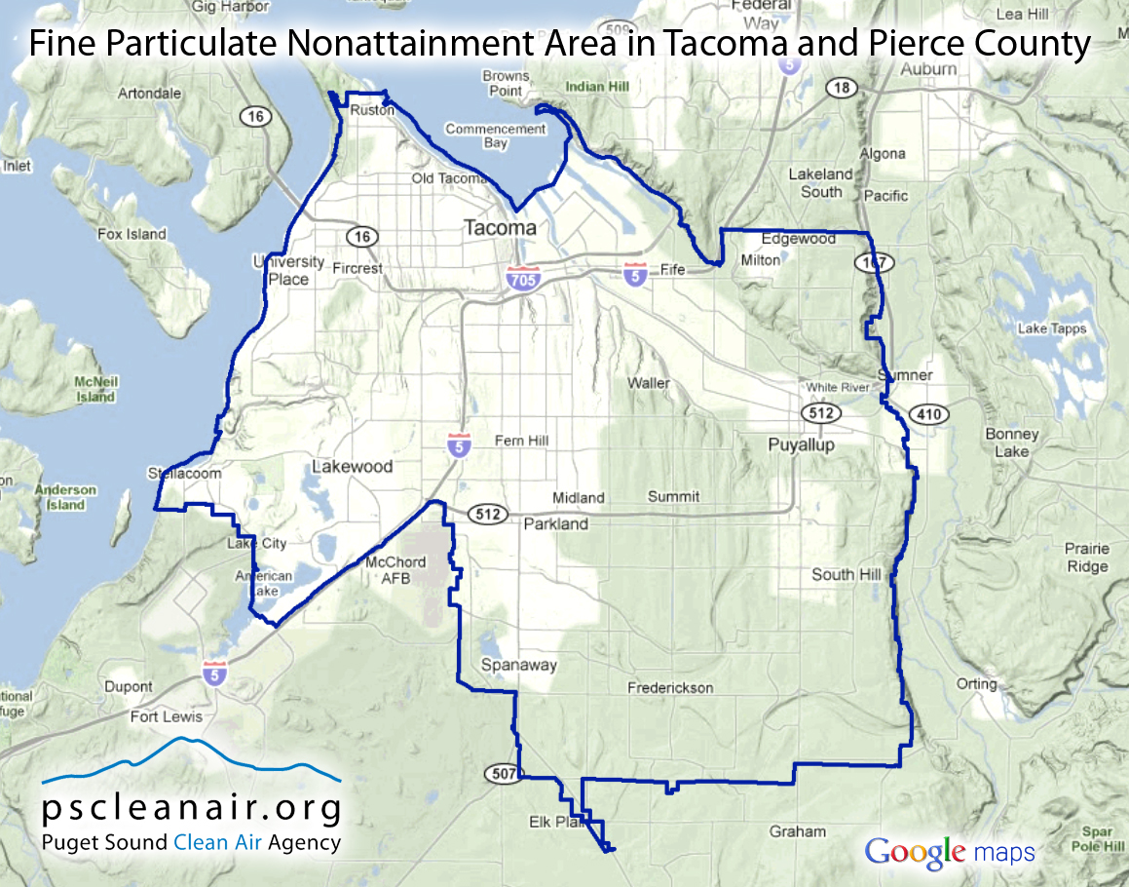
Tacoma/Pierce County WA Nonattainment Area (NA)
600,000 people affected
Wood Smoke in winter drives Nonattainment
Over 50% of wood burners get wood for free

Slide 3
Community Task Force
Set of strategies
Enhanced enforcement of burn bans
Date certain uncertified removal rule (Why not time of sale?)
Incentives- wood stove program
Legislature’s direction re: stove rule

Slide 4
Video

Slide 5
Video

Slide 6
Wood Stove Program
Funding: State capital budget, allocated by Department of Ecology for NA or at risk areas
Three parts:
Low income- full replacement cost and can get a certified stove
Not low income- $1500 incentive($1000 was too low) but cannot use for wood
Scrap stove, drop off/pick up-$200-350

Slide 7
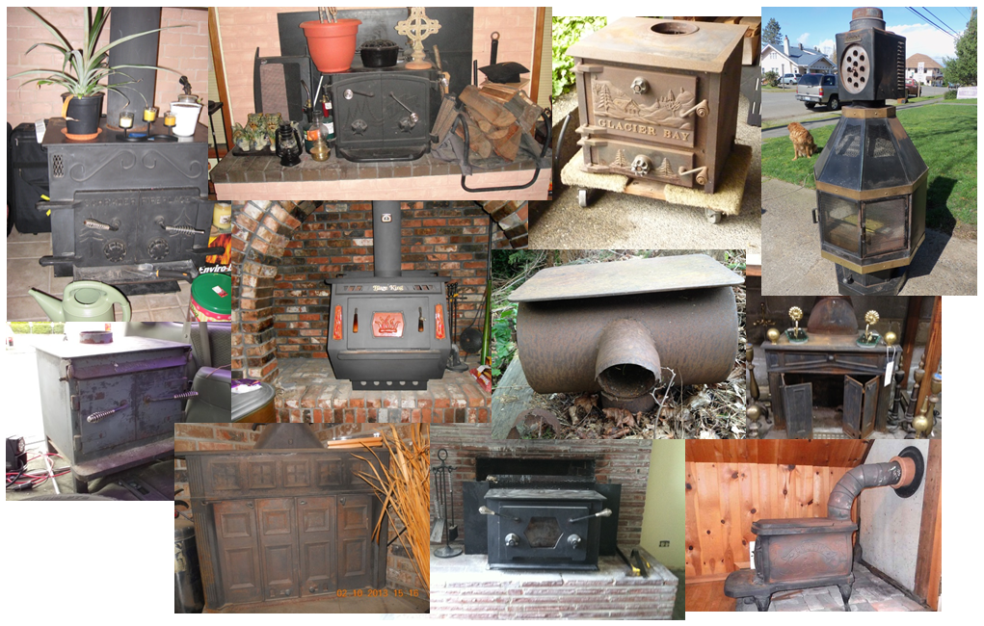
Results to date…
Nearly 2,400 old stoves/inserts removed!
Anticipate at least 500 more by June 2015

Slide 8
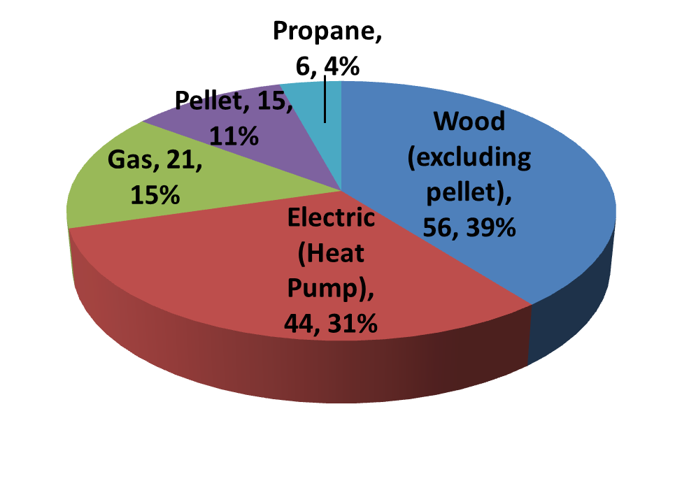
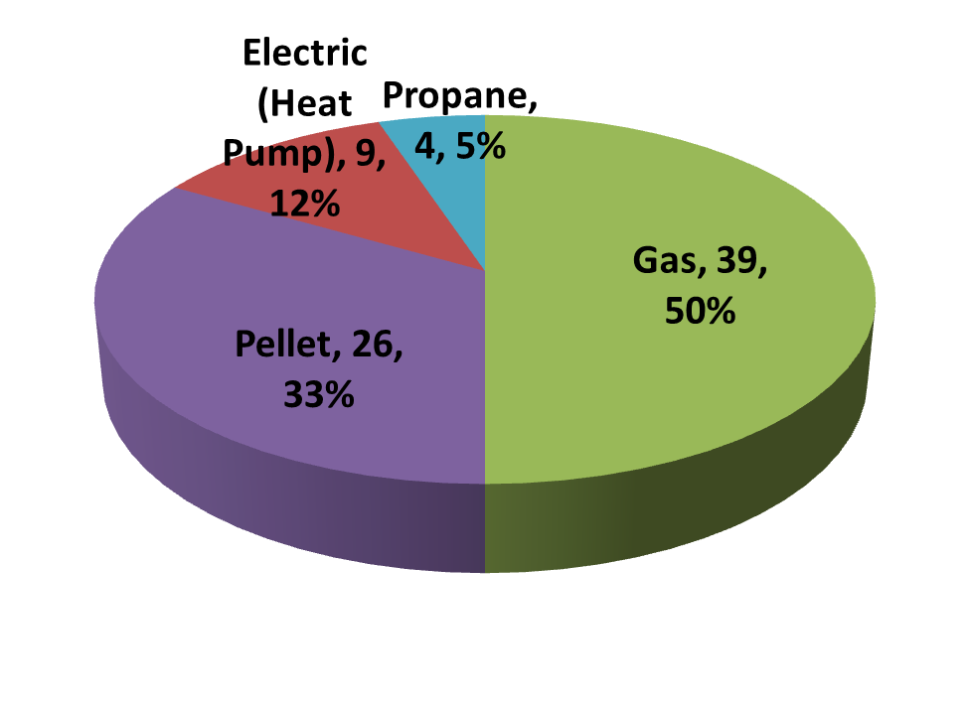
2013-14 Program Analysis – At-a-Glance New Fuel Choices
Income Qualified Replacement Discount

Slide 9
Community-based social marketing
Ask participants to help spread the word!
Put up a sign
Hand out flyers
Provide a testimonial
Post on Facebook
Their other ideas

Slide 10
Sample testimonials received
“This is a great program. I’ve been wondering what to do with the ‘dirty monster’ in my living room for years and along came the wood stove buy-back program!! It couldn’t have been easier—thanks WSRP for putting the beast to rest.” -- Louise from Tacoma (who received a $350 reward for scrapping her old wood stove)
“Replacing my wood fireplace insert with a gas insert gives me peace of mind, knowing that on the coldest days (when it seems that burn bans are most frequent) I can rely on a fire in my fireplace to give me a steady source of heat without risking a fine.” – Dan from Tacoma (low-income who received a free gas insert)

Slide 11
Keys to Success
No time gaps in program, use the Fair
Burn ban enforcement resolution option
Clear, fair and firm exemption for NOASH
Once low hanging fruit is gone, need carrots and sticks – what focus groups of wood burners told us

Slide 12
And for the Future…
Innocentive
Insert the challenge language and graphic

