Slide 1

Chapter 296-820 WAC – Wildfire Smoke
Chapter 296-307 WAC – Agriculture – Wildfire Smoke
Chris Pyke, M.S.
IH Technical Specialist
July 2024

Slide 2
Wildfire Smoke Rulemaking
Petitioned
Sep 2020
Emergency rule Summer 2022
Rule filed
Dec 2023
Emergency rule
Summer 2021
Rule effective
Jan 15, 2024
Sep 2020 L&I was petitioned to do rulemaking by United Farm Workers (UFW)
2021 and 2022 L&I adopted emergency rules
Prior to 2021 emergency rule, there were no regulations to address the hazards of wildfire smoke inhalation for workers in Washington.

Slide 3
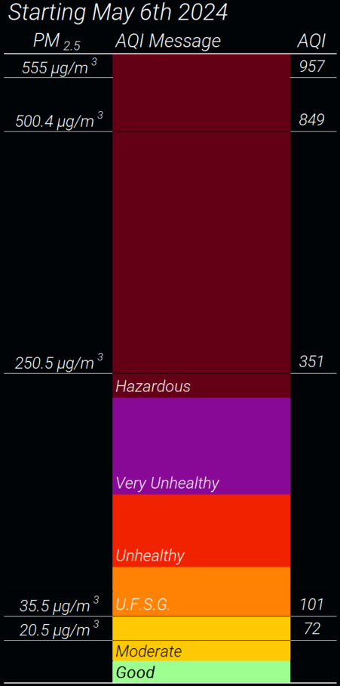
PM_{2.5}
PM_{2.5} is particulate matter 2.5 μm in diameter or smaller
The wildfire smoke rule is based on 1-hour average PM_{2.5} referred to as “Current PM_{2.5}”
PM_{2.5} is the primary pollutant of concern in wildfire smoke
Wildfire smoke also contains other contaminants
Particles in wildfire smoke are primarily 1 μm or smaller

Slide 4
The Air Quality Index (AQI)
The AQI is a unitless index created by the US EPA
Based on PM_{2.5} or other contaminants, whichever has highest AQI
AQI health messaging designed for the public, not occupational health
Outdoor workers are considered sensitive groups by WA Dept. of Health, Ecology, L&I, and the EPA.

Slide 5
The Air Quality Index (AQI)
Use of NowCast AQI for PM_{2.5} permitted as an approximation of the current PM_{2.5}
The regular AQI is based on 24-hour average PM_{2.5}
NowCast AQI averages over 3—12 hours

Slide 6
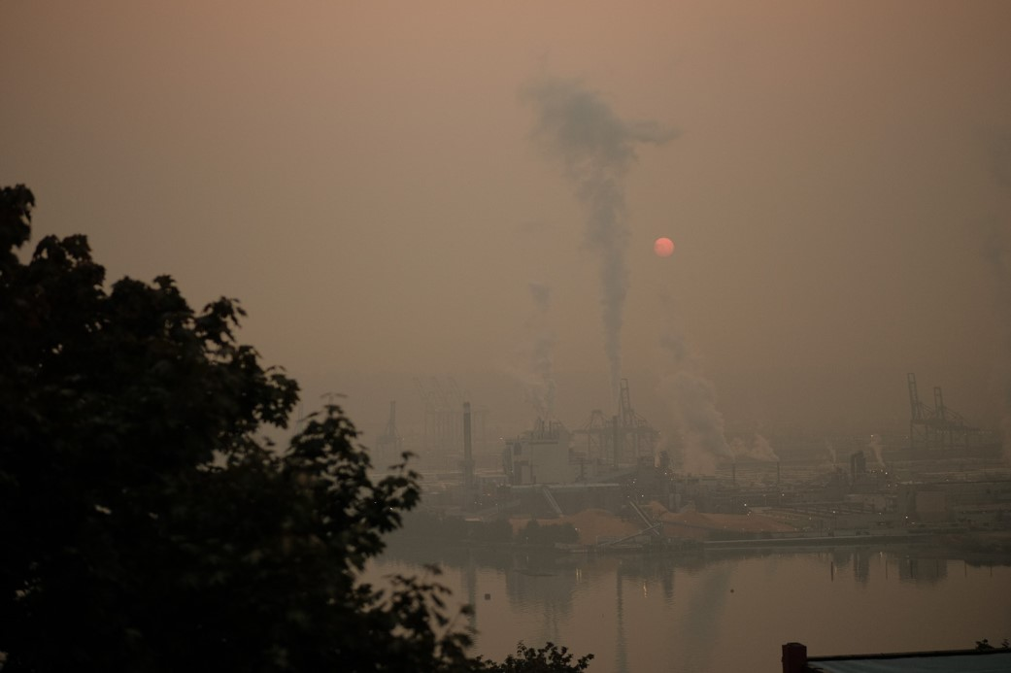
Less than 55 µg/m³ Chris Pyke, 2018 Note: Visual appearance is not an accurate method of determining the PM_{2.5}.

Slide 7
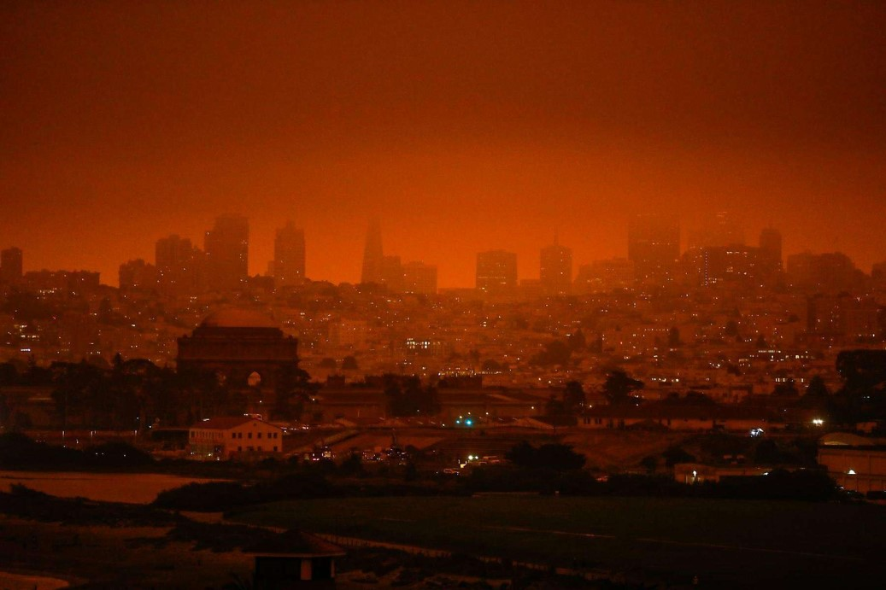
Less than 250 µg/m³ Gabriella Lurie SF Chronicle 2020 Note: Visual appearance is not an accurate method of determining the PM_{2.5}.

Slide 8
Who is covered by the rule?
WAC 296-820-805 and WAC 296-307-09805
This rule applies to all workplaces except:
Enclosed buildings where doors and windows are kept closed as much as possible
Enclosed vehicles where doors and windows are kept closed as much as possible
Firefighters covered by WAC 296-305
Workers performing prescribed burns

Slide 9
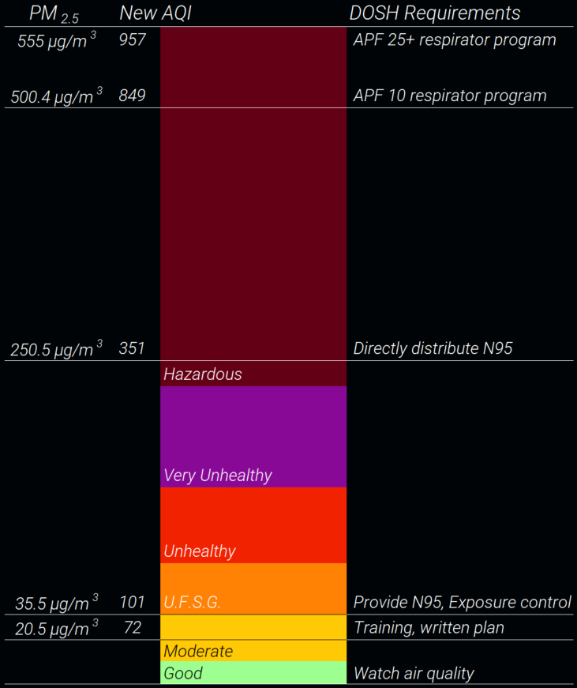
PM_{2.5} thresholds
The wildfire smoke rule is based on 1-hour average PM_{2.5} referred to as “Current PM_{2.5}”
Also allows use of the NowCast AQI for PM_{2.5}

Slide 10
AQI updates
The EPA updated the AQI breakpoints May 6th 2024
DD 8.20 provides interim instructions
The rule’s requirements are not changing
L&I proposing expedited rulemaking (CR-105) to update AQI references
Objection period closes July 22nd, 2024
All AQI values in this presentation will be referring to the updated AQI unless otherwise noted.

Slide 11
Identification of harmful exposures
WAC 296-820-815 and WAC 296-307-09815
Employers must determine the current PM_{2.5} for worksites covered by the rule by:
Checking current PM_{2.5} and PM_{2.5} forecasts from approved sources
Measure current PM_{2.5} using direct read PM_{2.5} sensors
Employers may use PM_{2.5} data from the nearest regulatory monitor
The employer’s methods for determining PM_{2.5} must be included in the written wildfire smoke response plan

Slide 12
PM_{2.5} public data sources
L&I PM_{2.5} Air Quality Monitoring (For outdoor workers, PM_{2.5})
  https://lni.maps.arcgis.com/apps/webappviewer/index.html?id=fb858e6515504275932f907bb08eac53
WA Ecology Air Monitoring Network (AQI and PM_{2.5})
  https://enviwa.ecology.wa.gov/home/map
WA Smoke Blog (Additional detailed information)
  https://wasmoke.blogspot.com/
EPA Fire & Smoke Map (AQI only)
  https://fire.airnow.gov/

Slide 13
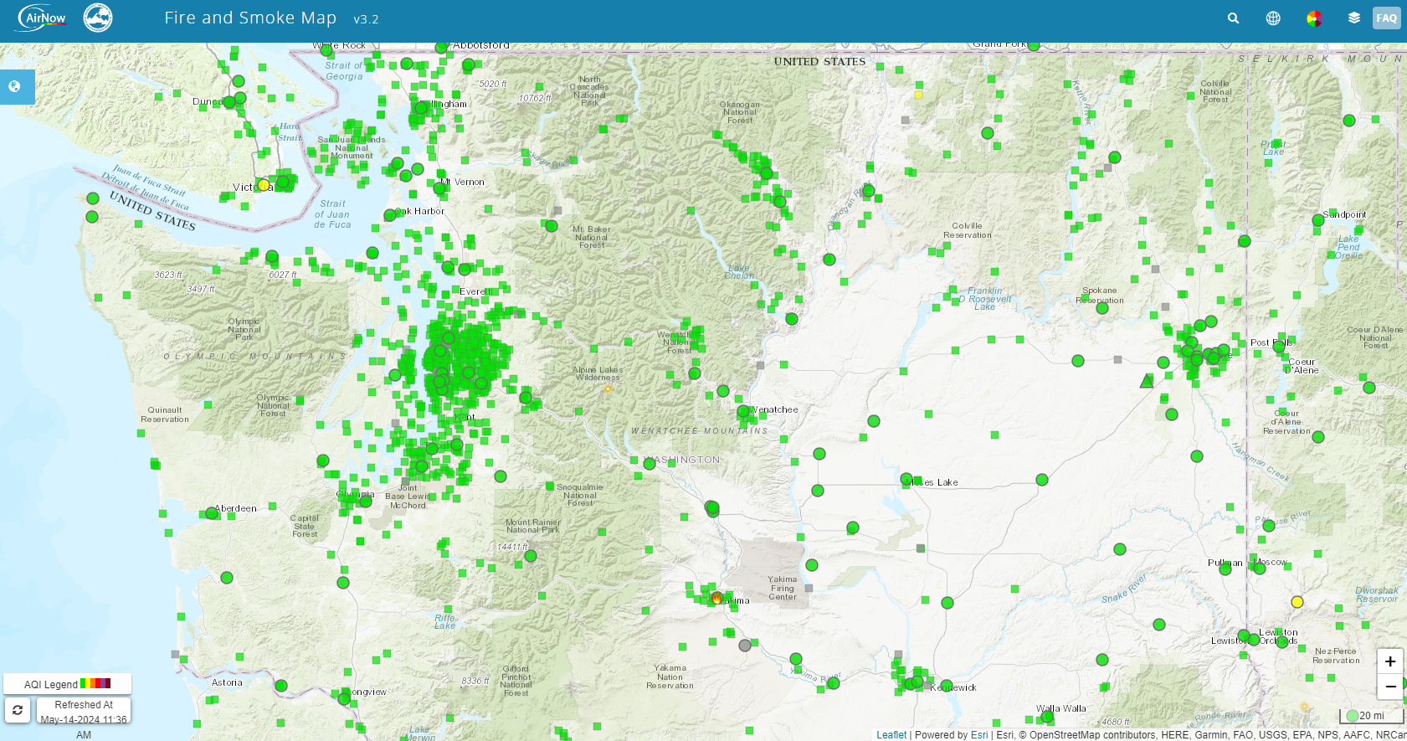

Slide 14
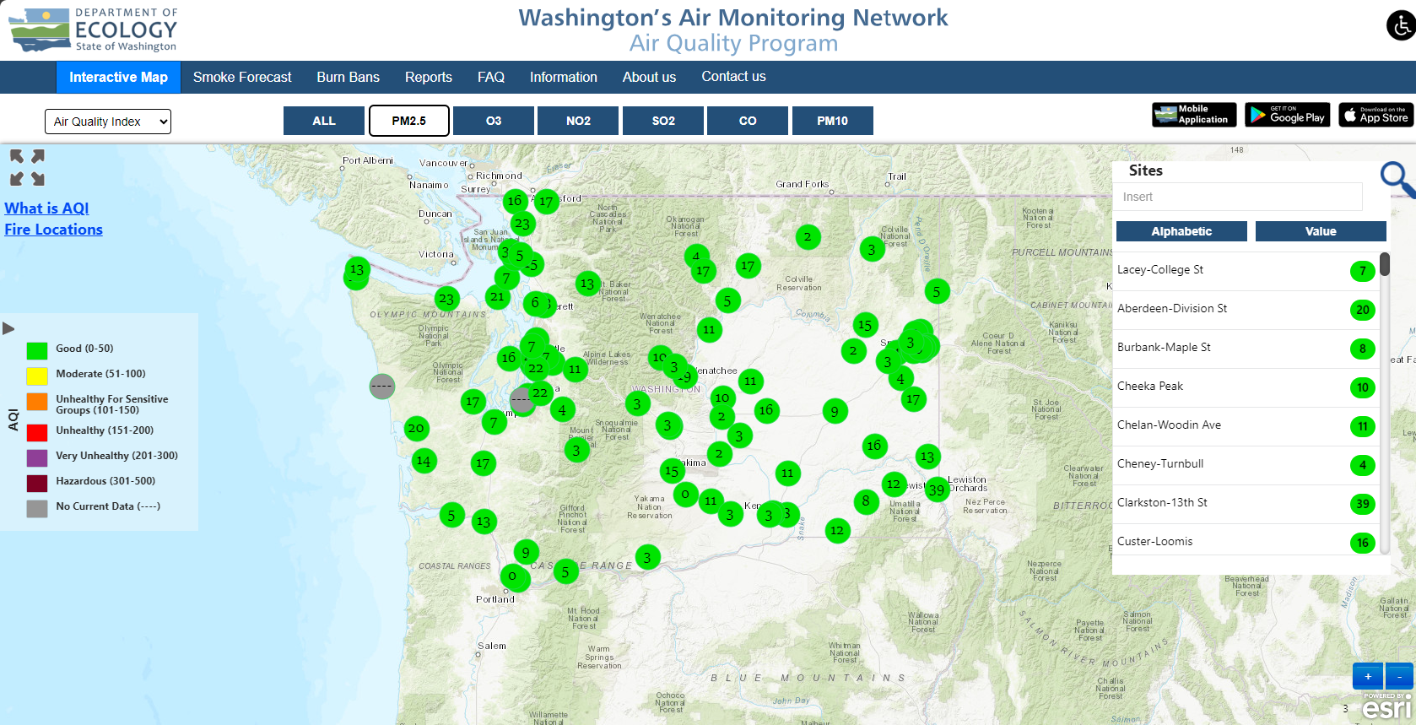

Slide 15
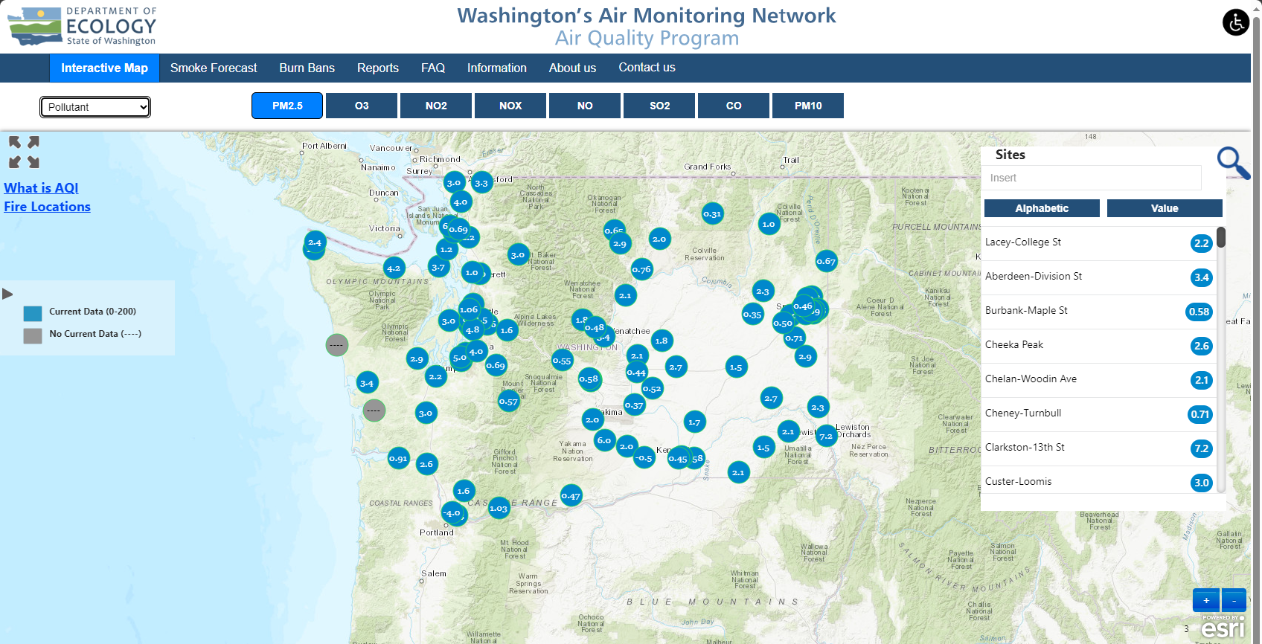

Slide 16
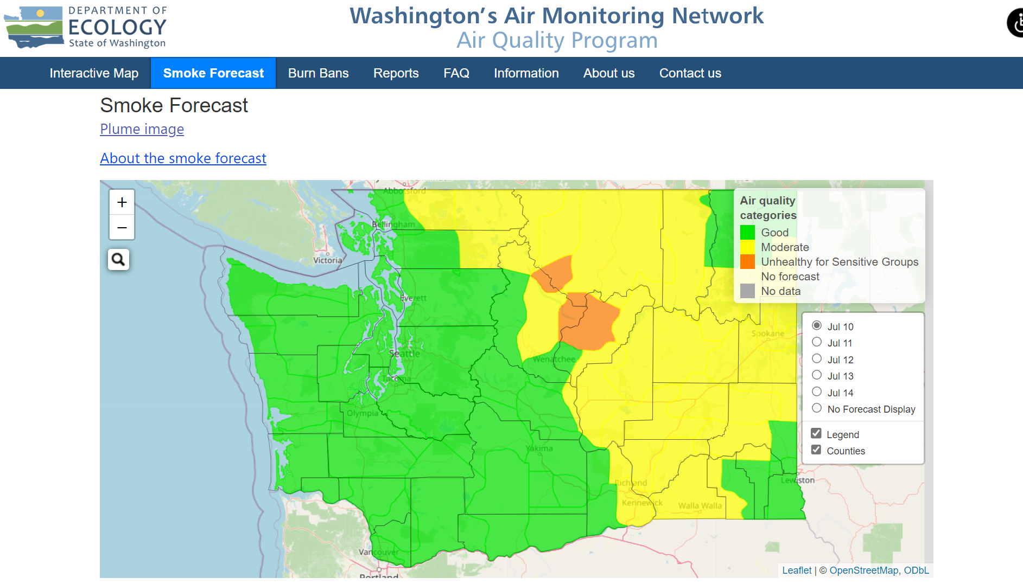

Slide 17
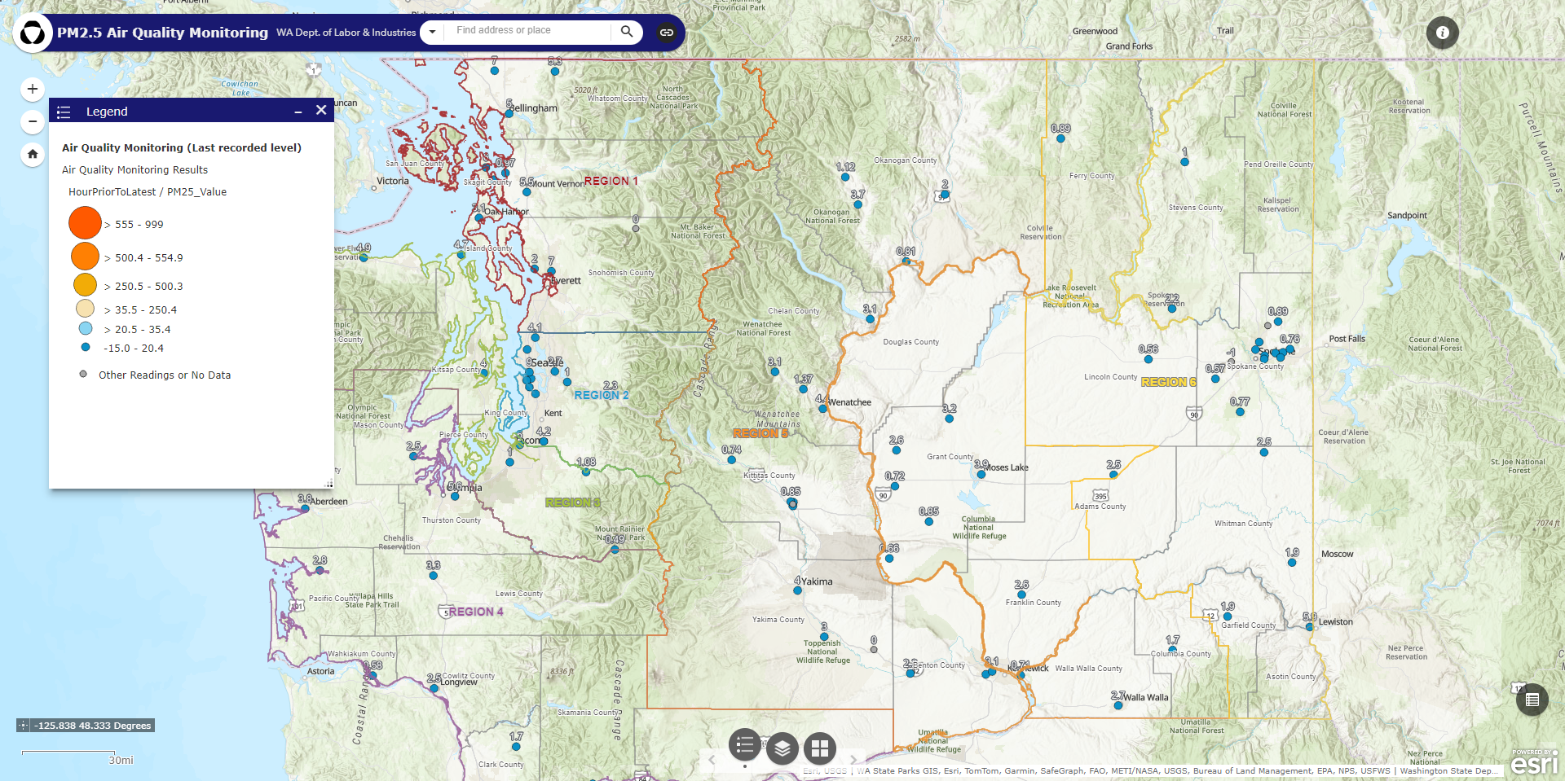

Slide 18
Exposure controls
WAC 296-820-835 and WAC 296-307-09835
At 20.5 μg/m³ (AQI 72) or more, the employer is encouraged to implement exposure controls
Exposure controls include both engineering, and administrative controls

Slide 19
Exposure controls
WAC 296-820-835 and WAC 296-307-09835
At 35.5 μg/m³ (AQI 101) or more, the employer must implement effective exposure controls whenever feasible such as:
Move work indoors. Provide portable HEPA air filters
Relocate or reschedule work to a place or time with better air quality
Avoid or reduce work that generates additional dust, fumes, or smoke
Reduce work intensity and provide additional rest periods

Slide 20
Respiratory protection
WAC 296-820-840 and WAC 296-307-09840
At 20.5 μg/m³ (AQI 72) or more, the employer is encouraged to provide respirators at no cost to employees upon request.
Employees may use their own respirators.

Slide 21
Respiratory protection
WAC 296-820-840 and WAC 296-307-09840
At 35.5 μg/m³ (AQI 101) or more, the employer must provide N95 filtering-facepiece respirators to all exposed employees, and encourage respirator use.
Employees may choose whether to wear respirators.

Slide 22
Respiratory protection
WAC 296-820-840 and WAC 296-307-09840
At 250.5 μg/m³ (AQI 351) or more, the employer must directly distribute N95 filtering-facepiece respirators to all exposed employees, and encourage respirator use.
Employees may choose whether to wear respirators.

Slide 23
Respiratory protection
WAC 296-820-840 and WAC 296-307-09840
At 500.4 μg/m³ (AQI 849) or more, employees must be enrolled in a complete respiratory protection program in accordance with WAC 296-842 Respirators.
The employer must provide, and require to be worn an N95 filtering-facepiece respirator, or other respirator with an assigned protection factor (APF) of 10 or more

Slide 24
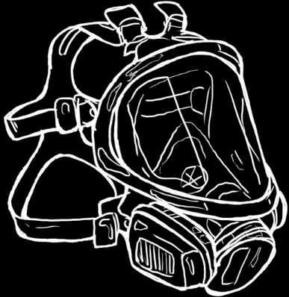
Respiratory protection
WAC 296-820-840 and WAC 296-307-09840
At 555 μg/m³ (AQI 957) or more, the employer must provide and require to be worn a respirator with an APF of 25 or more equipped with P100 filters.

Slide 25
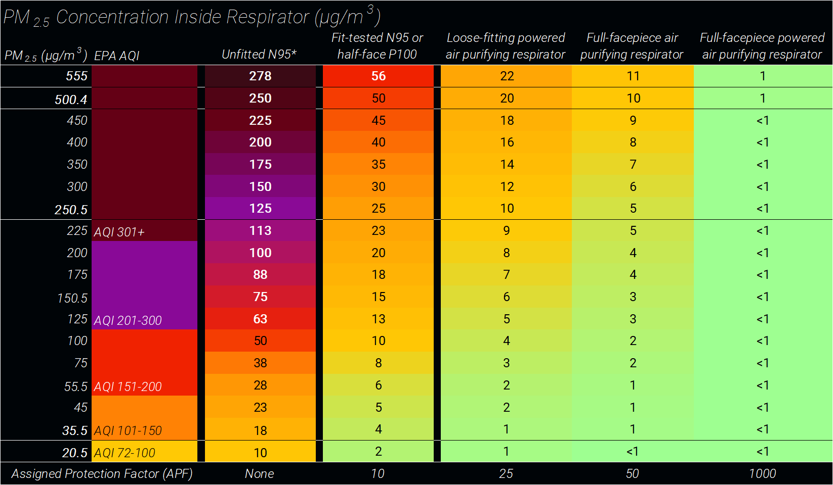
Notes:
Coffey1999 95th percentile total penetration (filter and face seal leakage) from 21 different N95 respirators.
"Therefore, on average, respirator wearers could expect to have 95% of their total penetrations to be upwards of 33%".
Ranges for unfitted respirators adapted from Coffey1999, and information from Kaitlyn Kelly DOH.

Slide 26
Exposure symptom response
WAC 296-820-830 and WAC 296-307-09830
Employers must allow workers to seek medical attention, or follow medical advice they have been given at all PM_{2.5} concentrations.
Monitor employees displaying symptoms and take steps to reduce or eliminate continued exposure.
Where the current PM_{2.5} 250.5 μg/m³ (AQI 351) or more, the employer must move employees displaying symptoms requiring immediate medical attention to clean air.

Slide 27
Beyond minimum requirements
PPE needed to keep exposures below 55.5 µg/m³
Notes:
Lee et al 2008
About 29% of N95 respirators [tested] … had PFs <10
The minimum PFs were observed in the size range of 0.04–0.2 µm.
doi:10.1093/annhyg/men005

Slide 28
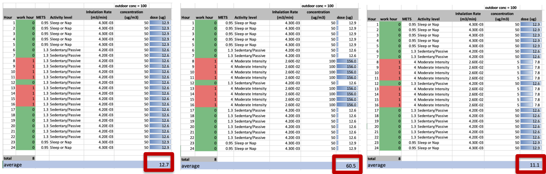
Wildfire smoke dose model
Jan 27, 2022 stakeholder meeting: Guest presentation by Elena Austin, ScD, MS and Edward Kasner, PhD, MPH. Slide 29.
https://www.lni.wa.gov/safety-health/safety-rules/rulemaking-stakeholder-information/_WildFire/Wildfire-Health-Threats.pdf.

Slide 29
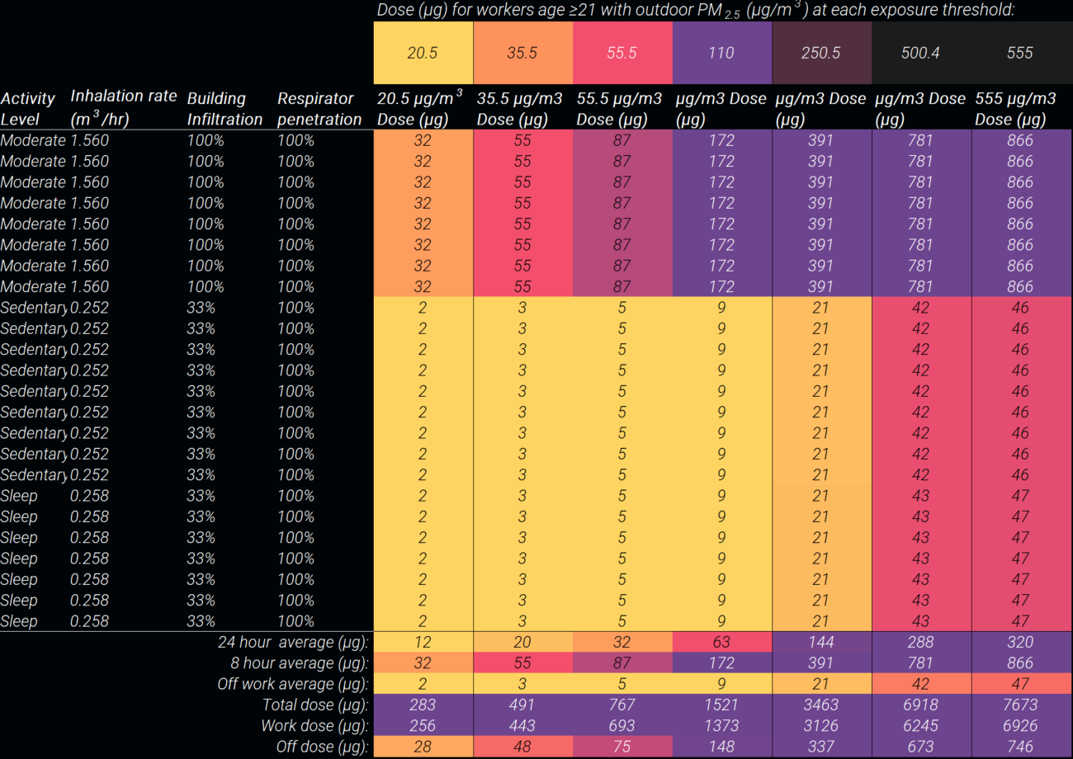
Modeling dose without respirator

Slide 30
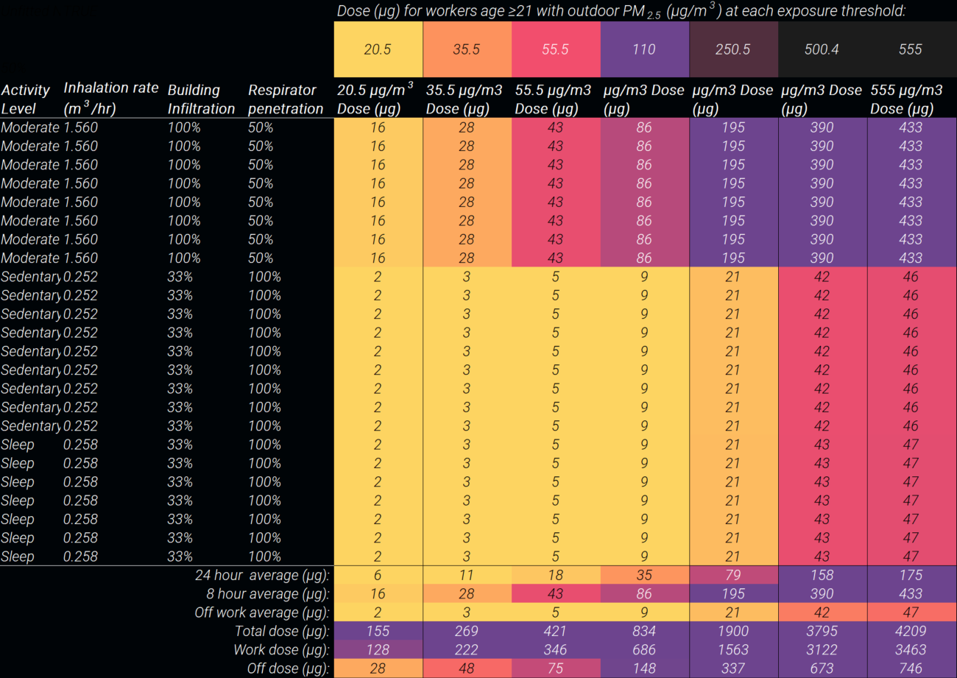
Modeling dose with voluntary respirator

Slide 31
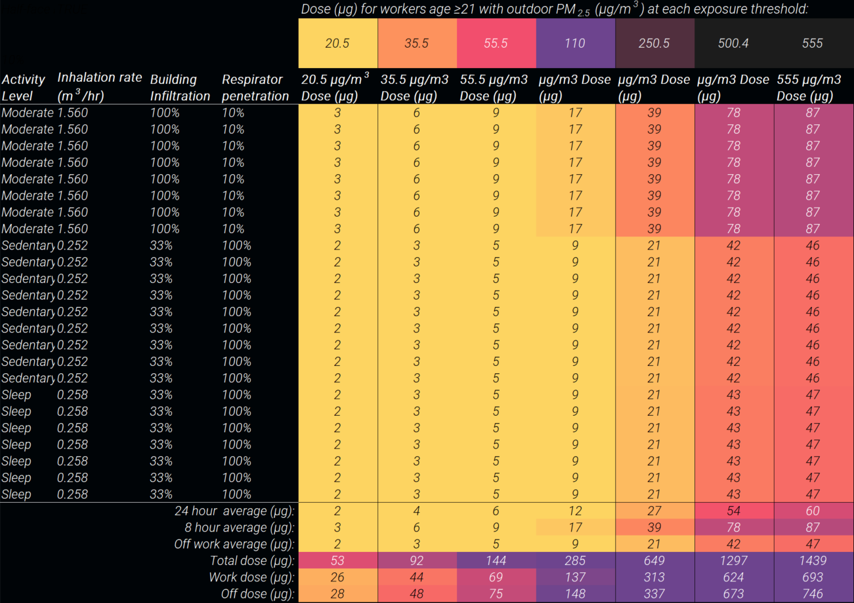
Modeling dose with fitted respirator

Slide 32

chris.pyke@lni.wa.gov
Wildfire Smoke

