Slide 1
wildfire smoke guidance
Annie Doubleday, PhD MPH
Ambient Air Quality Epidemiologist

Slide 2
Minor to deadly responses to wildfire smoke
Eye, nose, and throat irritation
Cough, wheeze, shortness of breath
Headaches
Fatigue
Irregular heartbeat, chest pain
Exacerbations of chronic lung and heart conditions
Overall increase in hospitalizations & deaths
Notes:
The symptoms from exposure can range from minor (such as eye, nose, and throat irritation) to headaches, wheezing, coughing, and shortness of breath, to more serious like exacerbations of pre-existing conditions such as lung and heart diseases, to even an increased risk of all-cause mortality. Most of these are associated with short term exposures to smoke and health effects of long-term exposure are relatively unknown.

Slide 3
Sensitive Groups with Increased Risk
People with health conditions
Lung & heart diseases
Respiratory illness
Diabetes
People 18 and younger
People 65 years and older
Pregnant people
Outdoor workers
People of color
Tribal and indigenous people
People with low income
Notes:
People can be at increased risk due to health status, life stage, lack of access to resources or health care, or environmental injustices that most seriously harm people of color. As a result, people with heart or lung disease, people younger than 18 and older than 65, pregnant people, outdoor workers, people of color, Tribal and indigenous people, or people with low income are some of those especially sensitive to smoke.
As we learn more about health impacts of PM2.5, this list is growing.

Slide 4
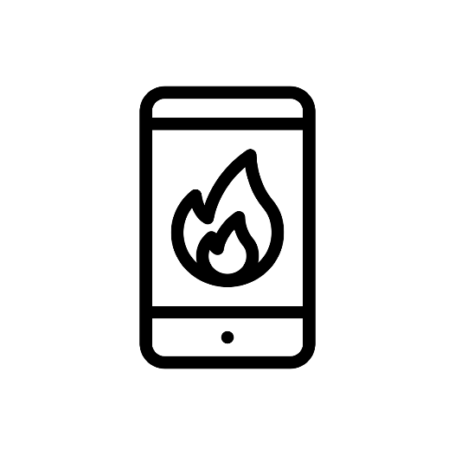
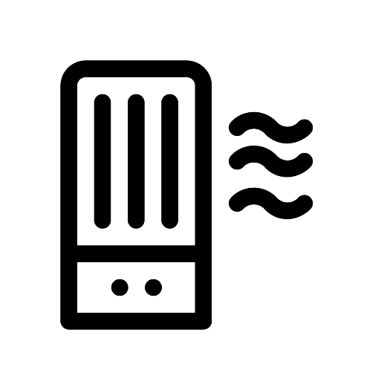
Steps to reduce exposure to smoke
1. Stay updated on current and forecast air quality
Check the air quality index (AQI)
2. Reduce exposure
Avoid strenuous outdoor physical activity
Limit time outdoors
3. Stay inside with cleaner indoor air
Close windows and doors, unless its too hot to maintain safe temperatures
Don’t add to indoor air pollution
Filter indoor air
HVAC system with a MERV 13 filter
Portable air cleaner with a HEPA filter
DIY box fan filter
If unable to maintain clean air at home, go elsewhere for cleaner air, such as a friend’s or public space
4. Pay attention to symptoms
Seek medical help if needed
Notes:
These are our best practices for individuals to reduce exposures during wildfire smoke events. These are tips that we hope everyone will learn and apply during wildfire smoke events.

Slide 5
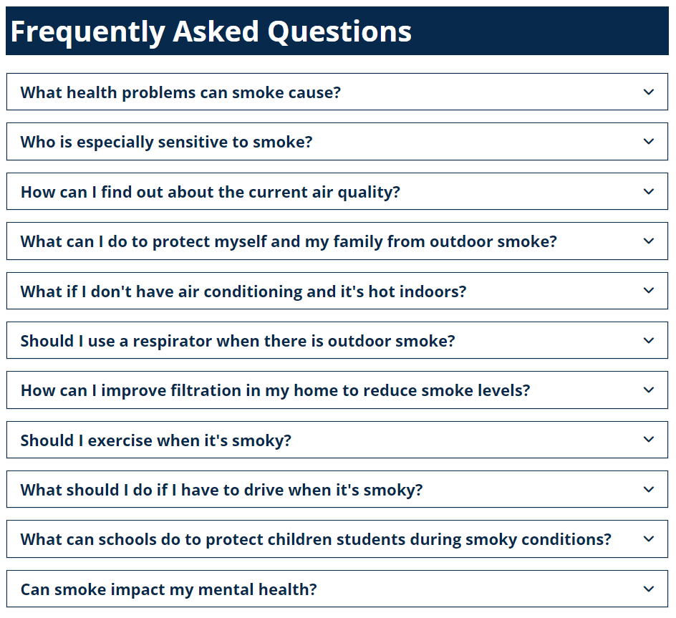
Smoke from Fires Webpage
www.doh.wa.gov/smokefromfires
Available in 9 languages
Notes:
Smoke from fires webpage, includes info for several FAQs about smoke. Geared more toward general public

Slide 6
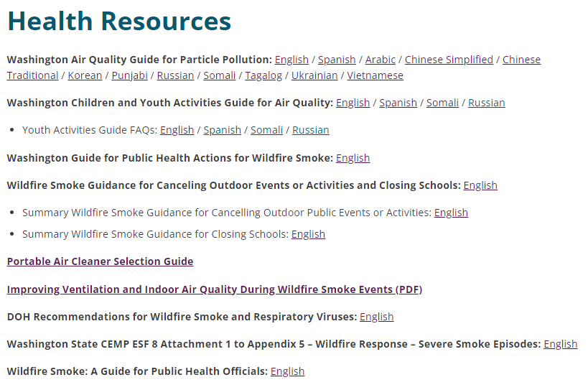
Smoke from Fires Toolkit
https://doh.wa.gov/community-and-environment/air-quality/smoke-fires/smoke-wildfires-toolkit
Notes:
Smoke from Fires partner toolkit. Geared more toward partners
Includes all of our guidance documents for what to do at different levels of air quality
Note: update coming soon to WFS and COVID overlap guidance; making it more general to include other respiratory viruses

Slide 7
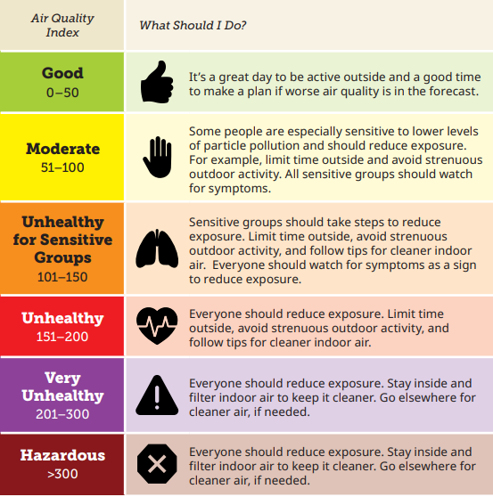
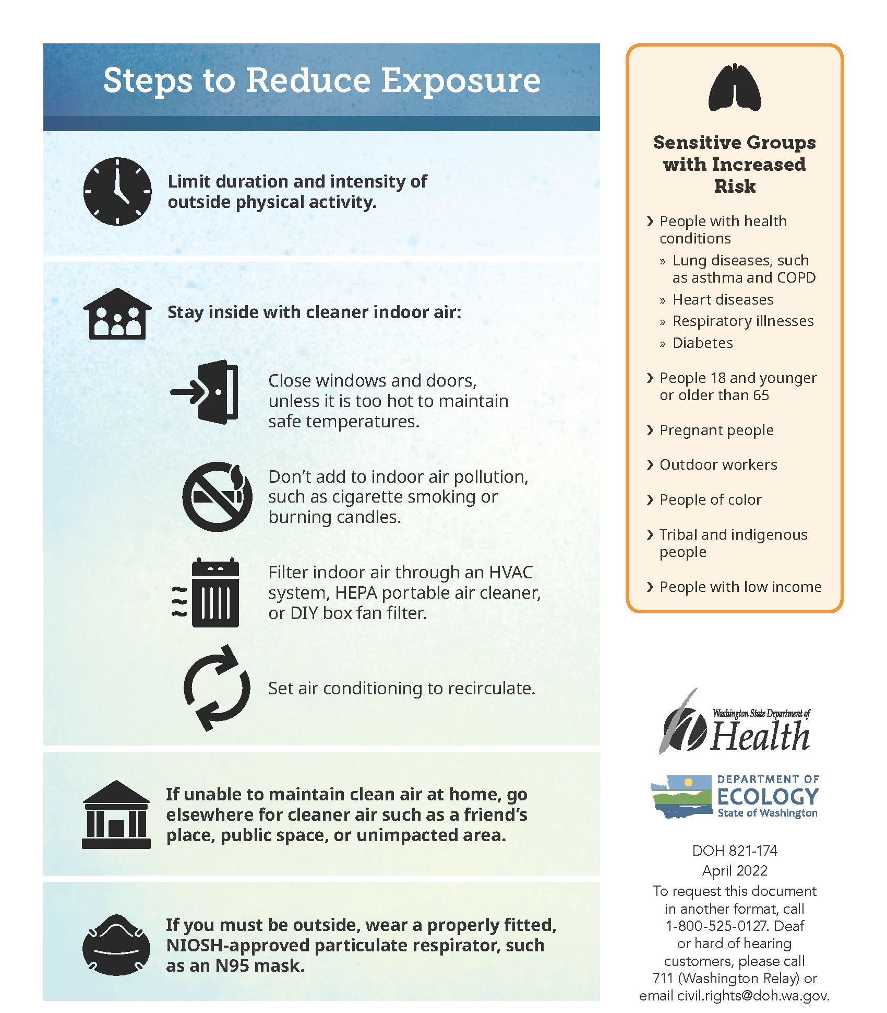
Washington Air Quality Guide for Particle Pollution
https://doh.wa.gov/community-and-environment/air-quality/smoke-fires/smoke-wildfires-toolkit
Notes:
One of our general pieces of guidance is the Washington Air Quality Guide for Particle Pollution catered toward the public
We provide guidance using the Air Quality Index (AQI), which reports the level of air quality and health concern across six categories
For more sensitive populations, we recommend people start to take steps to reduce exposure when the AQI is in the Moderate and above range, and especially when it is USG and above.

Slide 8
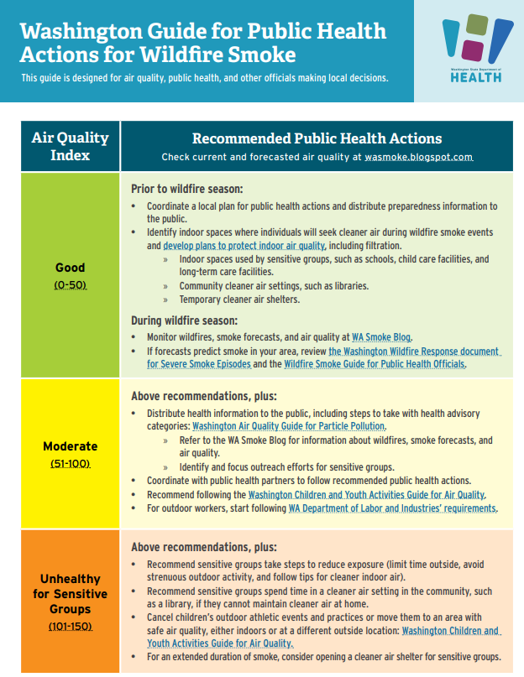
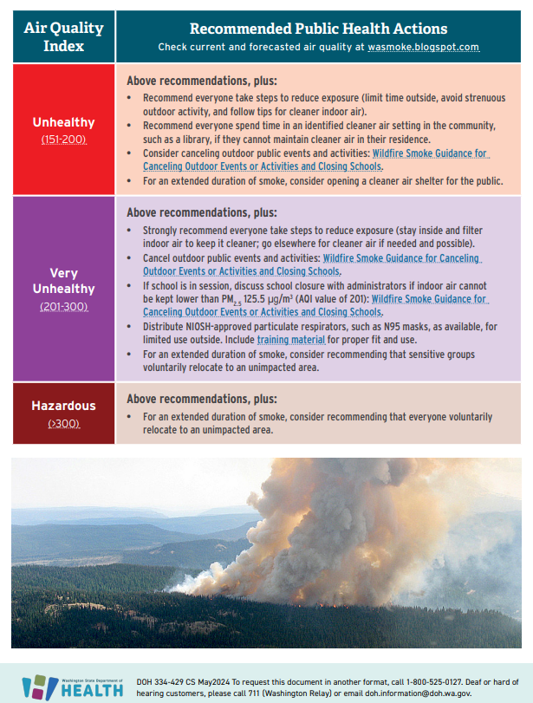
Washington Air Quality Guide for Public Health Actions for Wildfire Smoke
Notes:
This guidance is for general Public Health Actions for Wildfire smoke events, also shown by AQI category.
This guidance is catered toward partners rather than general public, though can be helpful. Links to other guidance documents, and helps point to when other guidance should be used, for example the children/youth activities guide, and the new LNI smoke rule for outdoor workers
Additionally, the EPA changed a couple of the AQI breakpoints in May. This means we will see more hours and days in the Moderate (yellow) category, and during WFS events, more hours and days in the Very Unhealthy and Hazardous categories.

Slide 9
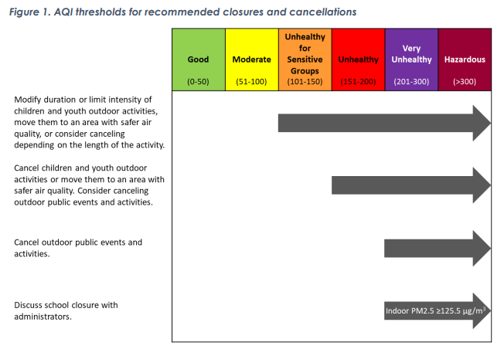
Recommended Action Levels: Outdoor Public Events
Wildfire Smoke Guidance for Canceling Outdoor Events or Activities and Closing Schools (wa.gov)
Notes:
This slide shows our recommended action levels for cancelling outdoor events and activities and closing schools.
At USG: We recommend that children and youth outdoor activities be shorter or to limit intensity, move to safer area, or consider cancelling depending on activity length.
At Unhealthy: We recommend cancelling children and youth outdoor activities, and to consider cancelling outdoor public events and activities
At Very Unhealthy: cancel outdoor public events and activities; and discuss school closures if indoor PM2.5 levels are this high
Note that the indoor PM2.5 concentration for discussion school closures lowered from 150 to 125.5 ug/m3. This is based on changes to the AQI that EPA made that went into effect in May.
This document is long and is meant for health officials but contains additional information to help guide in decision-making around closures.

Slide 10
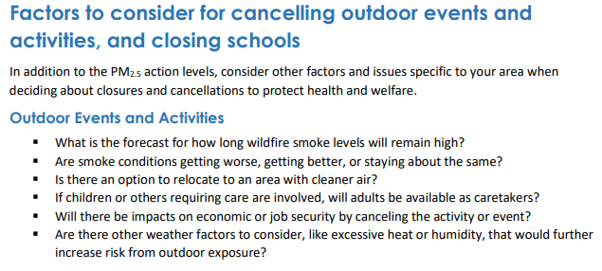
Recommended Action Levels: Outdoor Public Events
Notes:
Additional factors to consider for cancelling outdoor events and activities (p.2 of closures guidance)

Slide 11
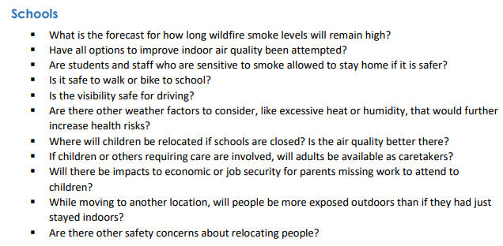
Recommended Action Levels: School Closures
Notes:
Additional factors to consider for closing school (p.2 of closures guidance)
This one is hard. We know that students’ homes may not be cleaner than the school environment

Slide 12
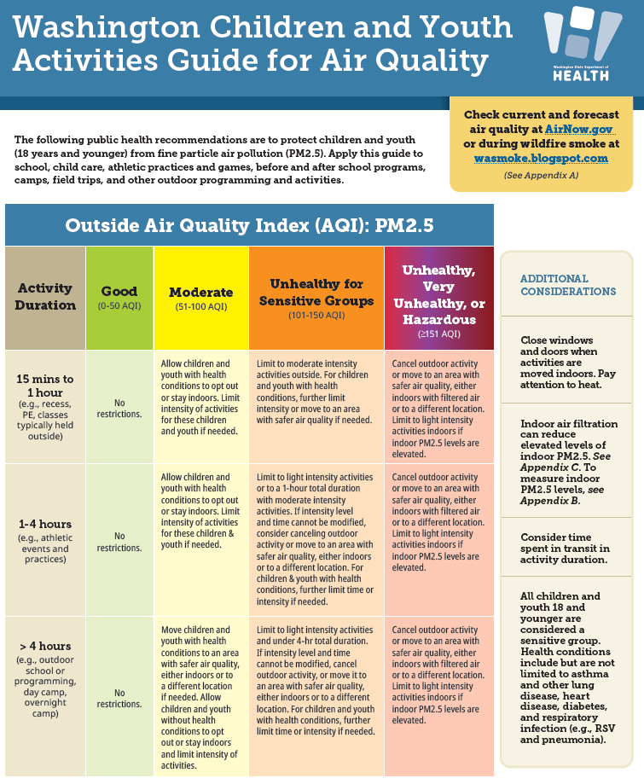
Recommended Action Levels: Children and Youth Activities
Washington Children and Youth Activities Guide for Air Quality
Notes:
This guidance shows more in depth the action levels for outdoor children and youth activities
Guidance for children and youth activities by activity duration and AQI. This guidance gets at both activity duration, activity intensity, and level of PM2.5.
For activities 1 hour or less, we recommend allowing children and youth with health conditions to opt out or stay indoors with AQI is moderate. At USG, we recommend limiting activity for all children to more moderate activities, and at Unhealthy and above, we recommend cancelling outdoor activities and/or moving to an area with cleaner air, either indoors or elsewhere.
For outdoor activities 1-4 hours, we recommend allowing children/youth with health conditions to opt out when the AQI is Moderate. If USG, we recommend limiting activity to light intensity, and cancelling at Unhealthy
For activities longer than 4 hours, we recommend moving children/youth with health conditions to an area with cleaner air if needed, and limiting activity to light intensity at USG

Slide 13
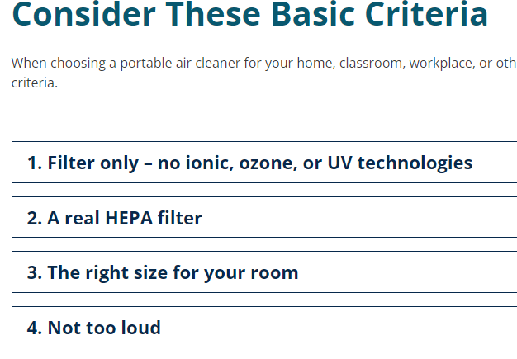
Portable Air Cleaner Selection Guidance (new)
https://doh.wa.gov/community-and-environment/air-quality/indoor-air/portable-air-cleaners
Notes:
We have newly developed guidance on Portable Air Cleaners to help understand what they are and how to select one. There are a lot of products on the market with technologies that are harmful to health, so this guidance helps weed through all of that.
Reminder to get your portable air cleaners or box fan filters now before smoke comes, or to replace your filters if you haven’t done so in a while!

Slide 14
Thank you!
WA DOH Air Quality Team
Julie Fox
Air Quality
Epidemiologist
Annie Doubleday
Ambient Air Quality Epidemiologist
Ann.doubleday@doh.wa.gov
Orly Stampfer
Indoor Air Quality
Epidemiologist
Kayla Hamme
Indoor Air Quality
Epidemiologist

