Slide 1
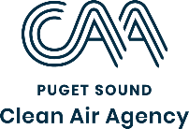
2024 Wildfire Smoke SEASON Coordination Background, Forecasting, and Messaging
July 2024

Slide 2
Overview
Background
Puget Sound Clean Air Agency – what we do
Health impacts
Anticipated 2024 season
How we communicate forecasts & resources available
On our website
Statewide resources

Slide 3
Background

Slide 4
What We Do
Oversee outdoor air quality in four counties
Monitor air quality in 4 counties
Provide air quality forecasts and education; declare air quality burn bans
Regulate stationary places that emit pollution into the air
Evaluate and address air impacts from transportation and wood/wildfire smoke
Promote partnerships and incentives to improve air quality
Notes:
- We coordinate with partners at state and federal level (Ecology and EPA) – several other local airs in WA state
We are a special purpose, regional agency established in 1967, mandated to uphold the Washington State Clean Air Act.
- We have jurisdiction over these 4 Western WA Counties-- the most populated Counties in our state, with the largest number of industries and the heaviest amount of transportation related pollution impact.
- High-level of what we do as an Agency.

Slide 5
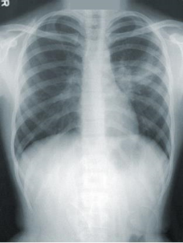
Wildfire Smoke and Health
Many health impacts with highly elevated fine particle pollution events (PM_{2.5}):
Respiratory irritation, asthma
Heart attack, stroke
Increased risk of premature death
Impacts greater for sensitive groups
https://unsplash.com/photos/NMZdj2Zu36M
The majority of health impacts for PM_{2.5} come from chronic (annual) exposure.
Overall, PM_{2.5} levels are improving over time in our region but wildfire smoke is reducing our gains
As wildfire smoke events lengthen, can begin to impact annual averages (and associated health impacts)
https://www.epa.gov/isa/integrated-science-assessment-isa-particulate-matter
https://ehjournal.biomedcentral.com/articles/10.1186/s12940-020-0559-2??utm_source=other_website&utm_medium=cpm&utm_content=leaderboard&utm_campaign=BSCN_2_DD_X-molfeed_MLS
Notes:
Reminder – we always show both with and without wildfire smoke in our data summaries. Even with wildfire smoke, we’re within strengthened standard (annual).
Reference for second on is ISA
https://assessments.epa.gov/risk/document/&deid=354490. Supplement to the Integrated Science Assessment for PM2.5. May 2022.

Slide 6
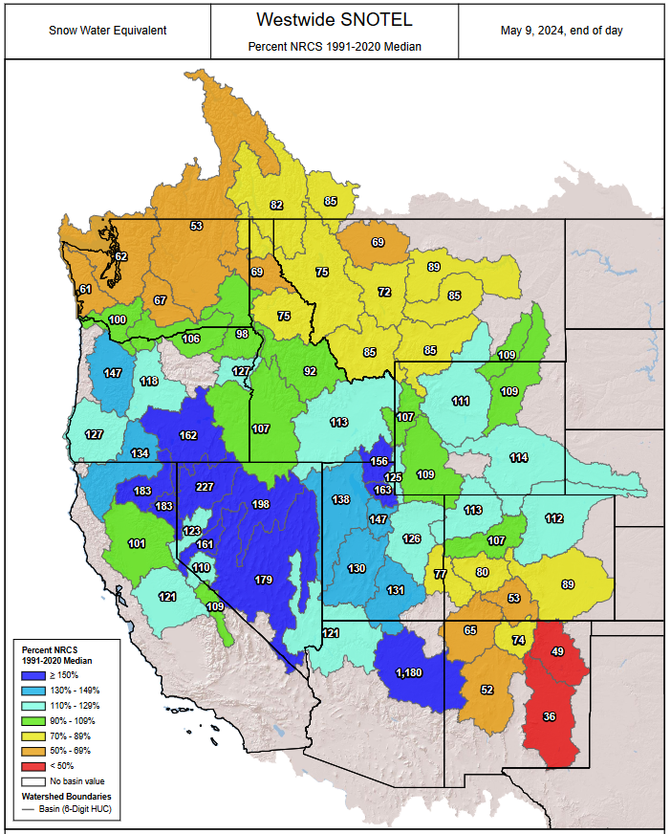
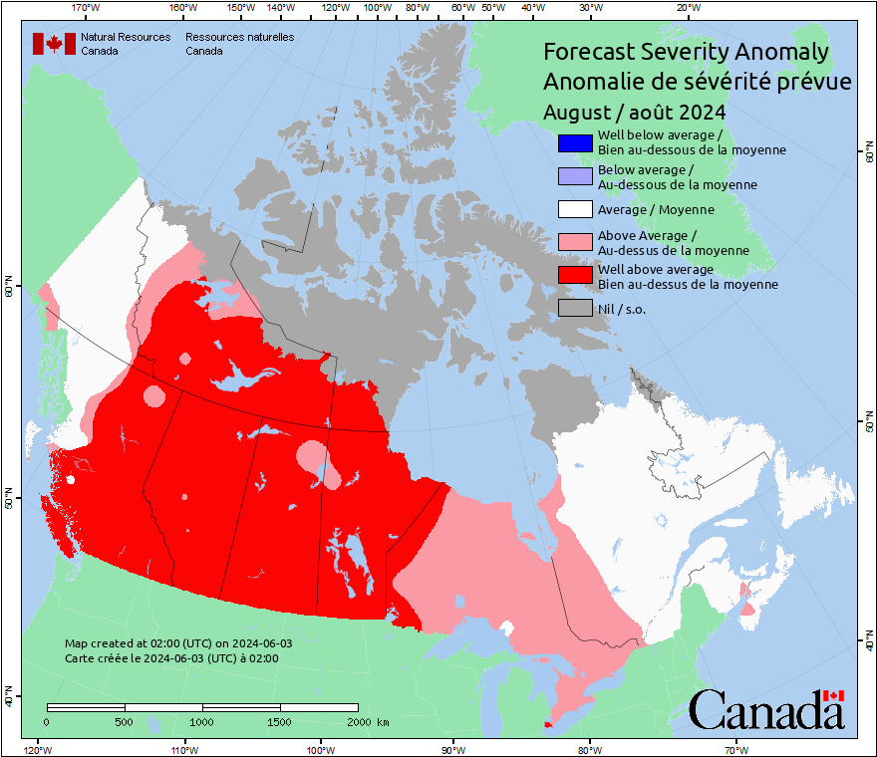
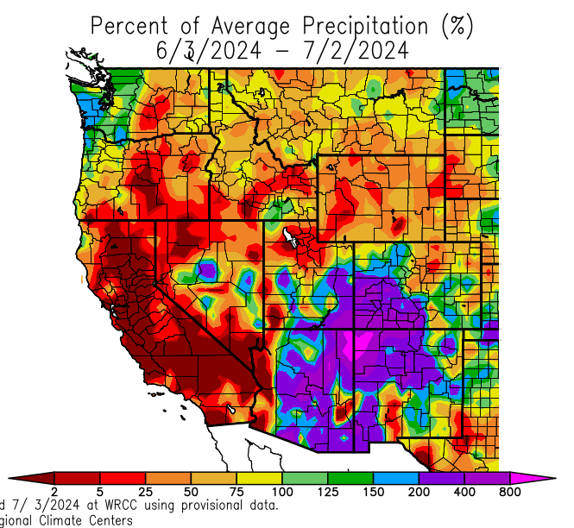
What will 2024 bring?
Canada and PNW season forecasts show higher than average chance
Last month has been drier than normal in Eastern WA and Oregon, but normal west of the Cascades
Seasonal outlook issued July 1, 2024: https://www.nifc.gov/nicc-files/predictive/outlooks/monthly_seasonal_outlook.pdf
Precip anomaly: https://wrcc.dri.edu/cgi-bin/anomimage.pl?wrc30dPpct.png
Snowpack anomaly: https://nwcc-apps.sc.egov.usda.gov/imap/#version=169&elements=&networks=!MSNT&states=!&basins=!&hucs=&minElevation=&maxElevation=&elementSelectType=any&activeOnly=true&activeForecastPointsOnly=false&hucLabels=false&hucIdLabels=false&hucParameterLabels=true&stationLabels=&overlays=&hucOverlays=state&basinOpacity=75&basinNoDataOpacity=0&basemapOpacity=100&maskOpacity=100&mode=data&openSections=dataElement,parameter,date,basin,options,elements,location,networks,baseMaps,overlays,labels&controlsOpen=true&popup=&popupMulti=&popupBasin=&base=esriWsr&displayType=basin&basinType=6&dataElement=WTEQ&depth=-8&parameter=PCTMED&frequency=DAILY&duration=I&customDuration=&dayPart=E&monthPart=B&forecastPubDay=1&forecastExceedance=50&useMixedPast=true&seqColor=1&divColor=7&scaleType=D&scaleMin=&scaleMax=&referencePeriodType=fixed&referenceBegin=1991&referenceEnd=2020&minimumYears=20&hucAssociations=true&relativeDate=-1&lat=43.241&lon=-105.285&zoom=5.2&autoExport=full,pdf,2,2,P,BL,Westwide%20SNOTEL,53.1005,29.8803,-100.0054,-127.0528
https://cwfis.cfs.nrcan.gc.ca/maps/forecasts?type=fsa&month=08
Notes:
May want to add when they start providing forecasts

Slide 7
How we Communicate Forecasts

Slide 8
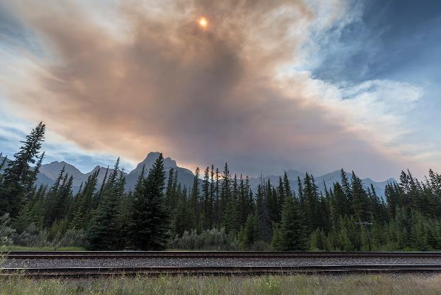
Our Primary Role – Technical Experts for Forecasting
We use several forecasting tools to anticipate smoke events and get the message out as quickly as possible to partners to amplify it
We are a small agency and rely on partnerships to spread the message quickly
We have local health jurisdictions we partner with and can often get the message out more broadly with larger networks
We have a joint press release with the local health jurisdictions that includes health messaging
Notes:
Verbal reminder - We have a quarterly coordination with health departments on AQ topics, including wildfire smoke

Slide 9
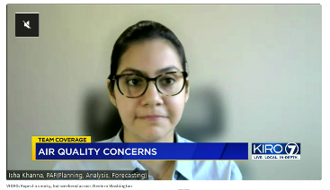
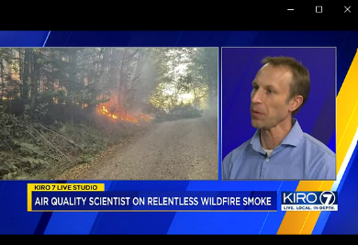
How to Find the Forecast
Our website: www.pscleanair.gov
Social media:
https://www.facebook.com/pscleanair/
https://twitter.com/pscleanair
Email sign-up list: https://bit.ly/2Tahu0X
For more detail on wildfire smoke: www.pscleanair.org/wildfire
We also push out messages with press releases, local TV forecasters, NWS, Ecology, EPA (includes Tribes), city and county partners.
Notes:
Verbally cover that we include lots of partners when we think there may be an event

Slide 10
Colors to Describe Air Quality
Called the “Air Quality Index”:
Color | Category
Green | GOOD
Yellow | MODERATE
Orange | UNHEALTHY FOR SENSITIVE GROUPS
Red | UNHEALTHY
Purple | VERY UNHEALTHY
Maroon | HAZARDOUS
Based on 24-hours of air pollution exposure.
Notes:
EPA just updated thresholds on May 6th based on strengthening the NAAQS – moderate will be 9 ug/m3 (instead of 12) – so expect we will see more moderate days in our jurisdiction (days that previously would have been “good”)

Slide 11
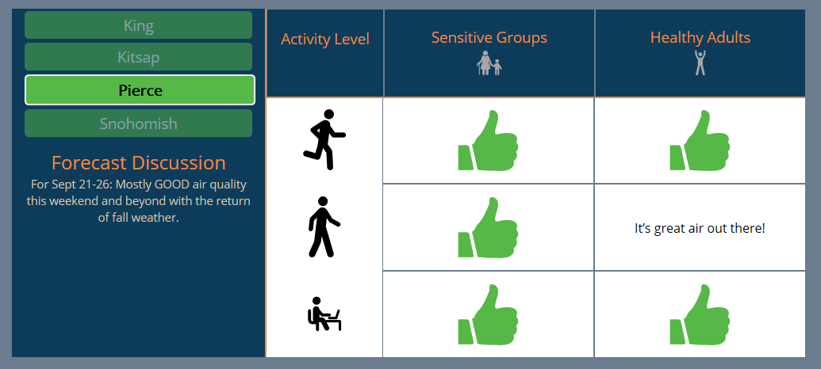
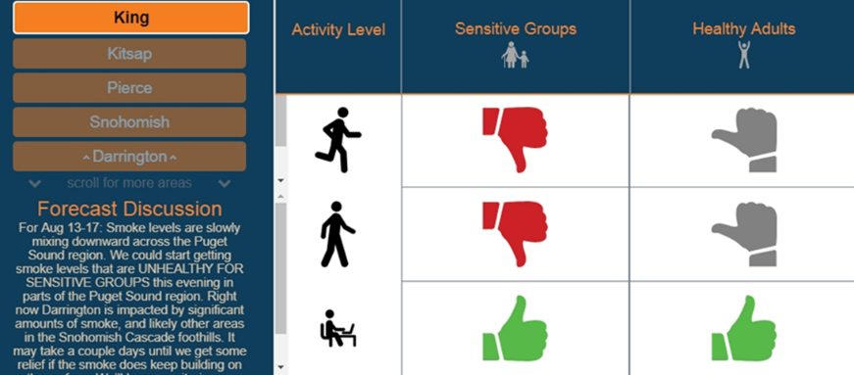
How to Find the Forecast
“Activity forecast” – daily county level forecasts on pscleanair.gov
Thumbs change based on air quality

Slide 12
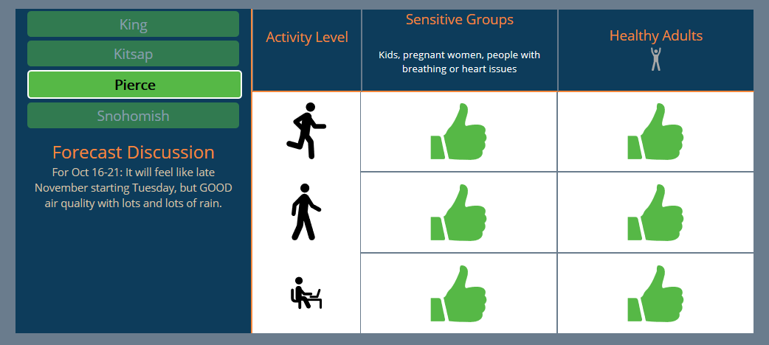
How to Find the Forecast
Pressing or hovering over icons gives more detail

Slide 13
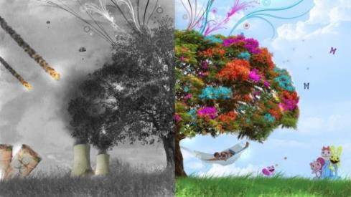
Forecasts Can be Conservative
County level forecasts are protective of the highest air pollution level in the county
Some areas may have good air quality within the same county
So how can you know what to do if you think you may have better air quality?

Slide 14
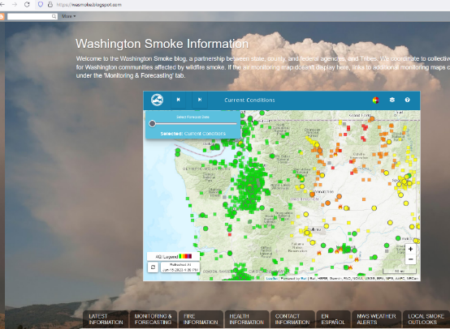
How to Find the Forecast
State level forecasts --- WA Smoke blog: http://wasmoke.blogspot.com/
Multi-agency effort to update it—often includes our jurisdiction

Slide 15
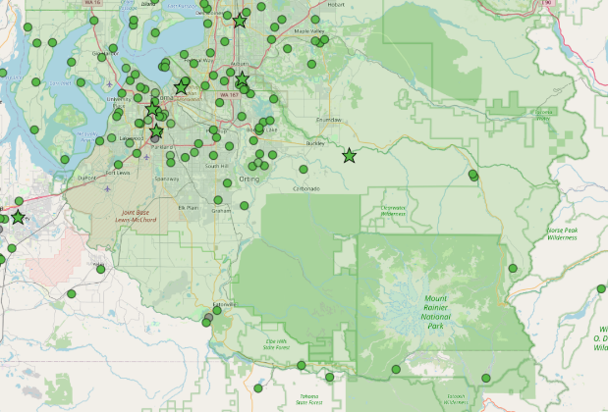
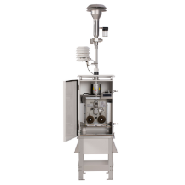
How to Look at Current Levels
https://map.pscleanair.gov
Uses EPA calibration, built in quality assurance
“Instant” view

Slide 16
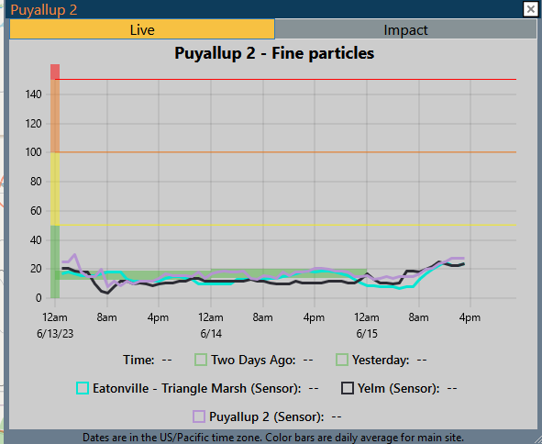
How to Look at Current Levels
https://map.pscleanair.gov
Graphs multiple sites over the last three days
Shows both units of AQI and concentration if needed

Slide 17
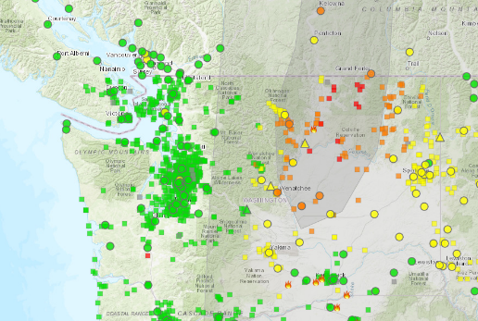
How to Look at Current Levels Across States
https://fire.airnow.gov/
Gives wider view outside of Puget Sound
Also shown on the WA Smoke Blog

Slide 18
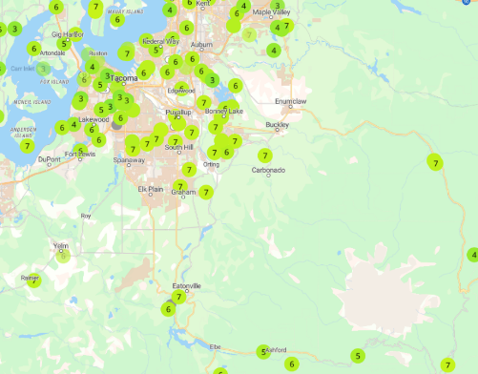
Another Site to See Current Levels
https://map.purpleair.com/
Can be confusing - defaults include indoor air sensors, averaging times confusing
Need to specify EPA correction because without it the sensors read double actual values
Color transitions aren’t as clear (MODERATE can often look orange)
Notes:
What about timing? Instantaneous? Isn’t a key issue that they don’t include nowcast type averaging but display AQI for instant values?
Beware of other sites - Non-AQI color scales
Other sites lump or average when zoomed out
Unknown sources of where the information is coming up and often doesn’t match

Slide 19
Burn Bans
Air Quality vs. Fire Safety Burn Bans
Air quality burn bans are issued and enforced by the Puget Sound Clean Air Agency when air pollution may reach or reaches unhealthy levels. Air quality burn bans typically occur during colder fall and winter months.
Fire safety burn bans are issued by the fire marshal when dry weather conditions heighten the risk of wildfires. Fire safety burn bans are generally called during the summer and can last for several months.
Puget Sound Clean Air Agency is NOT responsible for issuing or enforcing fire safety burn bans.
For more on fire safety bans, contact your county fire marshal.
We don’t need air quality burn bans for wildfire smoke as there’s typically fire safety burn bans already in place.

Slide 20
Thank you and Questions

Slide 21
Extra slides

Slide 22
Wildfire Smoke and Health
Many health impacts with highly elevated fine particle pollution events (PM_{2.5}):
Trouble breathing, respiratory irritation, asthma attack
Chest pain, heart attack, stroke
Increased risk of premature death
Impacts greater for sensitive groups
https://unsplash.com/photos/NMZdj2Zu36M
The majority of health impacts for PM_{2.5} come from chronic (annual) exposure.
Overall, PM_{2.5} levels are improving over time in our region but wildfire smoke is reducing our gains
As wildfire smoke events lengthen, can begin to impact annual averages (and associated health impacts)
https://www.epa.gov/isa/integrated-science-assessment-isa-particulate-matter
https://ehjournal.biomedcentral.com/articles/10.1186/s12940-020-0559-2??utm_source=other_website&utm_medium=cpm&utm_content=leaderboard&utm_campaign=BSCN_2_DD_X-molfeed_MLS
Notes:
Reminder – we always show both with and without wildfire smoke in our data summaries. Even with wildfire smoke, we’re within strengthened standard (annual).
Reference for second on is ISA
https://assessments.epa.gov/risk/document/&deid=354490. Supplement to the Integrated Science Assessment for PM2.5. May 2022.

Slide 23
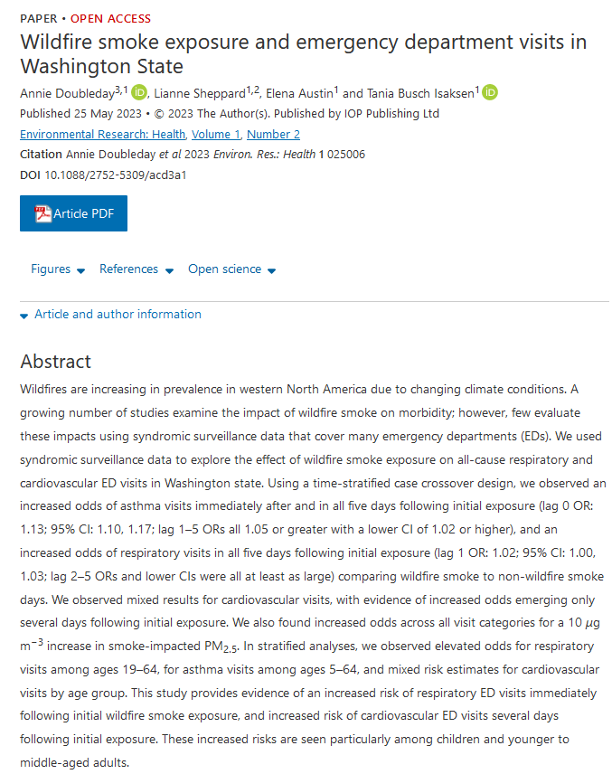
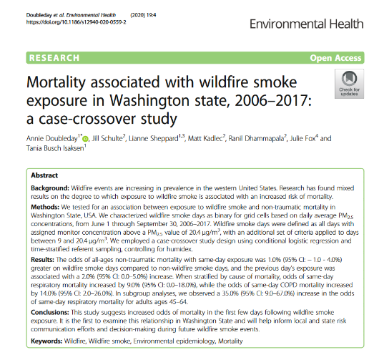
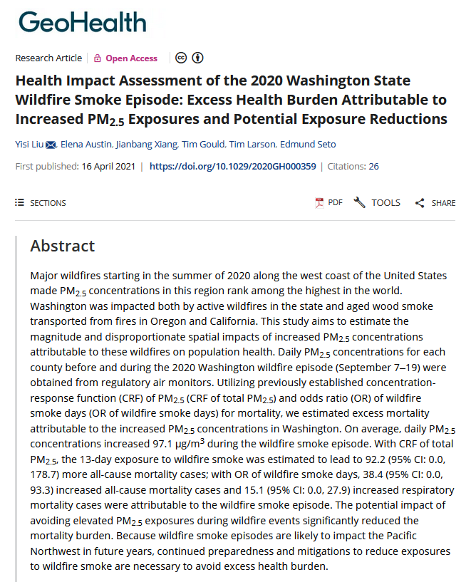
Study of past WA State wildfire smoke shows health impacts
Reminder – Majority of health impacts driven by chronic (annual average) PM_{2.5} exposure
https://iopscience.iop.org/article/10.1088/2752-5309/acd3a1
https://ehjournal.biomedcentral.com/articles/10.1186/s12940-020-0559-2??utm_source=other_website&utm_medium=cpm&utm_content=leaderboard&utm_campaign=BSCN_2_DD_X-molfeed_MLS
https://agupubs.onlinelibrary.wiley.com/doi/full/10.1029/2020GH000359
Notes:
Takeaway is that people are looking at these wildfire smoke events…
Increases aren’t dramatically higher (some imagine 5 times the risk, etc), but important nonetheless.
An estimated 728 (1.3%) deaths were attributable to air pollution in Washington in 2019. https://apps.ecology.wa.gov/publications/UIPages/documents/2302115.pdf Ref is GBD

Slide 24
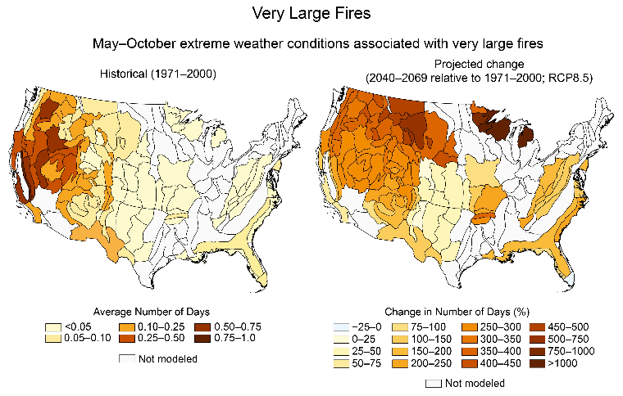
Future of Wildfire Smoke
“The number of days with conditions associated with Very Large Fires more than doubles in many ecosections, with more than a fourfold increase for parts of the Northwest.”
5th National Climate Assessment, 2023, https://nca2023.globalchange.gov/chapter/7/#key-message-1

Slide 25
Our forecasting tools

Slide 26
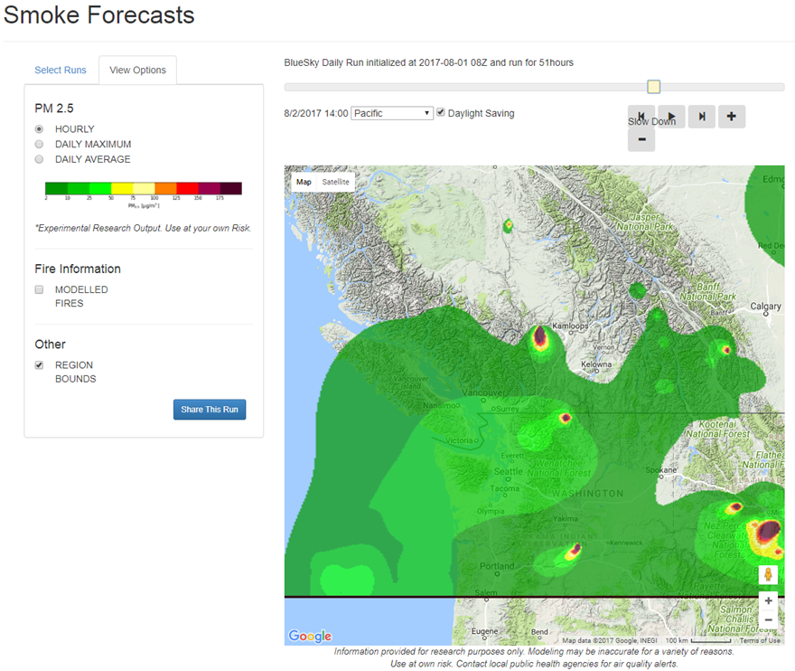
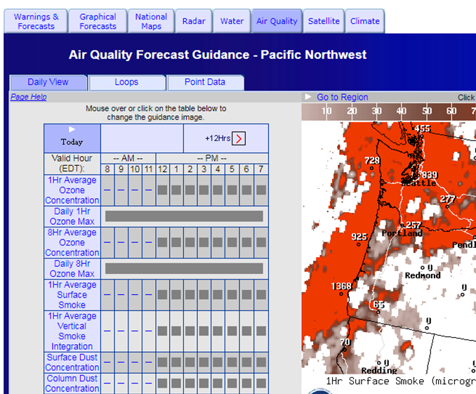
Modeling wildfire smoke is hard!

Slide 27
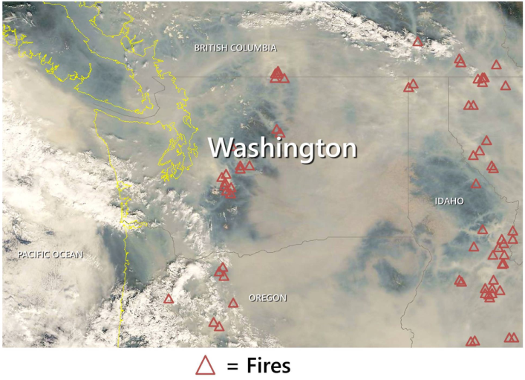
Satellites images help, but lack vertical information
2018
2017

Slide 28
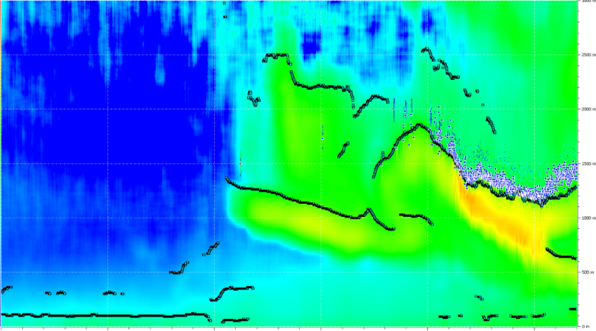
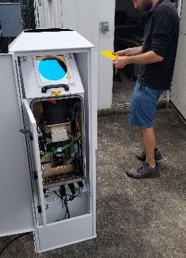
Vertical air measurement: the ceilometer
Ash Event (Sep 4, 2017)
We are now operating 4 in our region, and Ecology hosts another
Other regional partners (Oregon, EPA) are using them more
We host the display and data on our website: http://apps.pscleanair.gov/Ceil/home.html
3km
2.5km
2.0 km
1.5 km
1.0 km
0.5 km
0 km
Fog
Fog
Fog
SMOKE
Ash
INVERSION
Stayed MODERATE air on surface
Noon
Midnight
Time

Slide 29
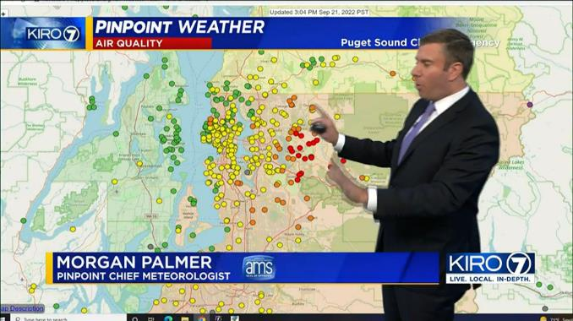
Our tools in the media

Slide 30
What can people do about wildfire smoke exposures?

Slide 31
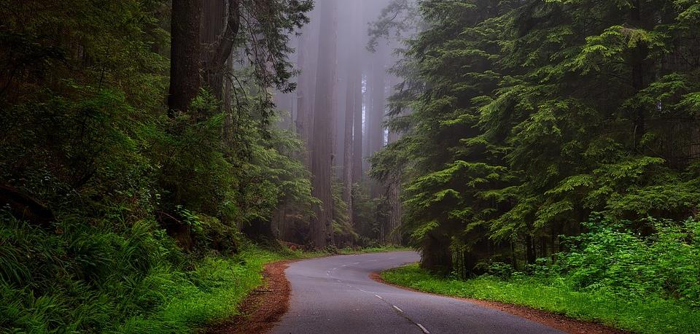
Be Prepared
Check the air quality forecast and current levels regularly
If the air looks and smells smoky, avoid outdoor activities if possible
Stock up on supplies, medications, and other items you may need for your family and pets so you can avoid going outside

Slide 32
Be Prepared (page 2)
If possible, purchase an indoor air filter or use “DIY” filter
Designate a room in your home to be a “clean room”. Doors and windows should remain closed to prevent smoke coming in
Know where the nearest “cooling center” is located. Cooling centers, like libraries or community centers, could be your best place for you to avoid smoky air

Slide 33
Stay indoors
Even without filtration – indoor PM_{2.5} levels are roughly half outside levels if doors and windows closed
If too hot indoors, try to find a cool place elsewhere (e.g. cooling centers)
If you must be outside, consider a mask to reduce exposure

Slide 34
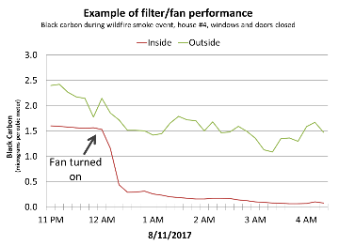
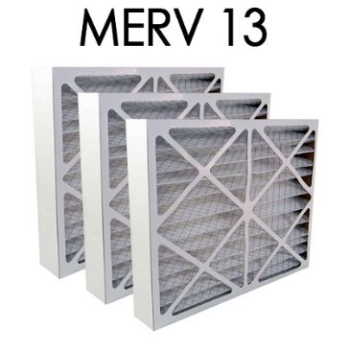
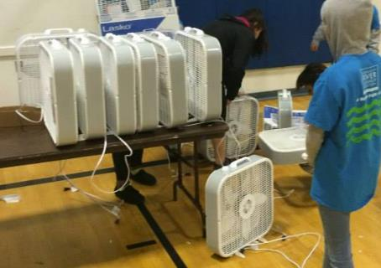
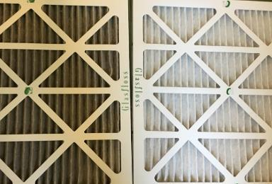
DIY Filter-fan kits
Partners have programs hosting community workshops to distribute
All supplies cost about $50
Before
After

Slide 35
Conclusions
Generally, we expect more wildfire smoke in the future
Our website is a great place to stay informed and direct any questions: www.pscleanair.gov
Our social media (Facebook and Twitter) may also have more recent updates
This presentation focuses on forecasting and communicating wildfire smoke events and reducing exposure
Climate change (and warmer, drier conditions) is an established key contributor to wildfire risk
Our Agency and partner actions to reduce greenhouse gas emissions – if replicated at scale and over time – could reduce wildfire smoke

Slide 36
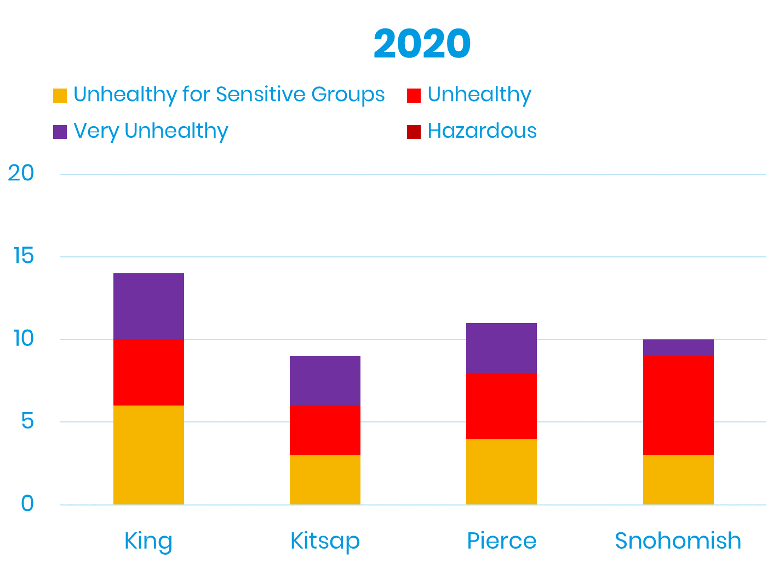
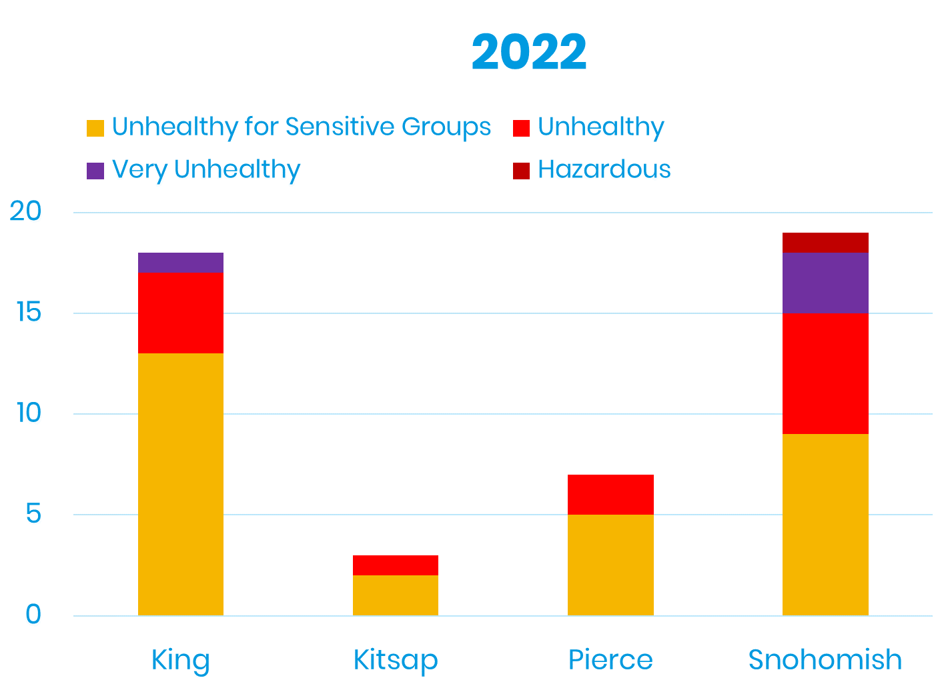
Majority of days in “good” and “moderate” year-round
More smoke in recent years

Slide 37
Who oversees your air quality?
National Level
State Level
Local Level

Slide 38
Other sites and apps have serious limitations
Non-AQI color scales
Other sites lump or average when zoomed out
Unknown sources of where the information is coming up and often doesn’t match
Notes:
Examples? Elephant one ☺

