Slide 1
Overview of Permitting + Complaint Response
Nina Lawonn, Inspector Puget Sound Clean Air Agency

Slide 2
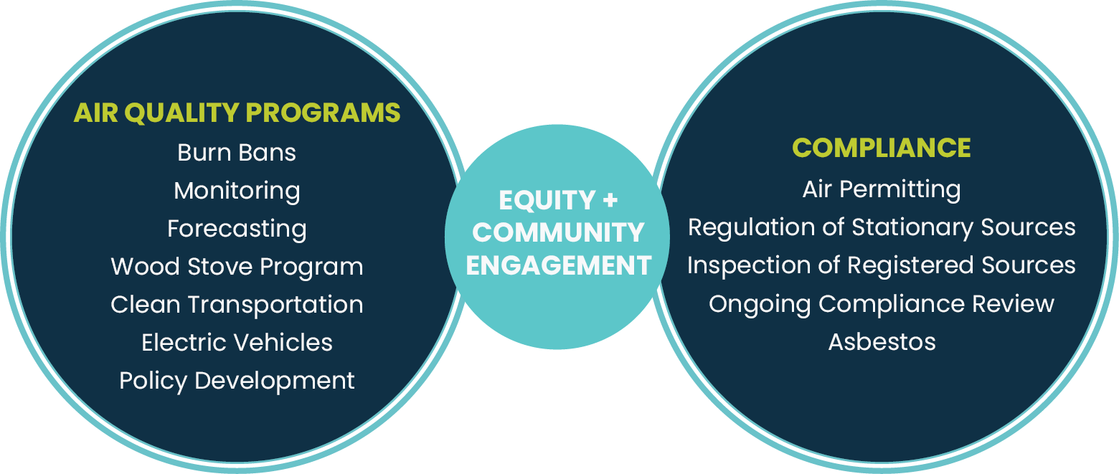
What We Do
Notes:
This shows an example of the variety of things that we do at the Agency.

Slide 3
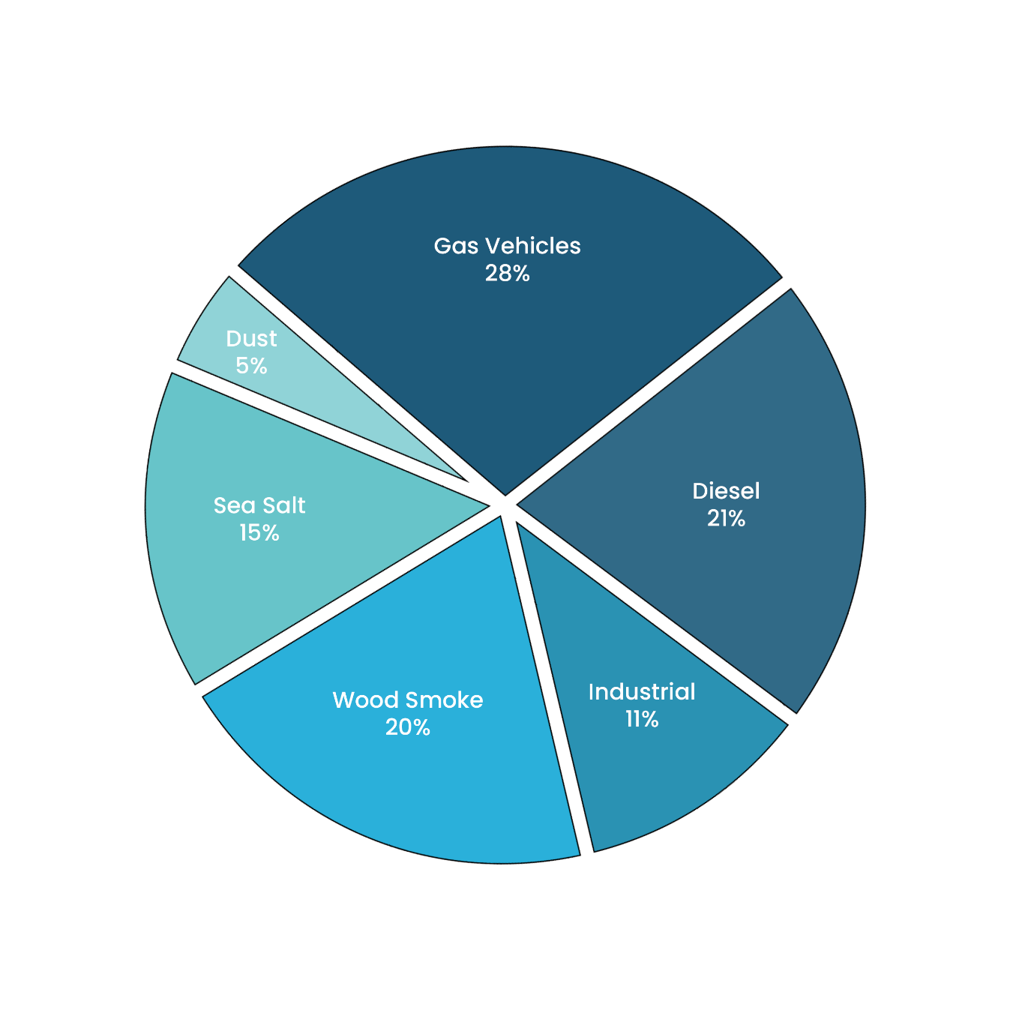
Duwamish Valley – Types of Pollution Sources
Adapted from Kotchenruther 2013
Notes:
Segue into: the Agency regulates Industrial sources which represent 11% of the total emissions in the area through permitting and inspections… and now we will talk a little bit about that looks like.
Later we will circle back to talk about how the Agency regulates wood smoke and fugitive dust.

Slide 4
What Compliance Does
Prevent, reduce, and control emissions and exposure from significant sources of air pollution.
Limit asbestos emissions and exposure from projects, renovations, and demolitions through education, enforcement and partnerships.
Build relationships, educate and engage with communities about the health risks of air quality issues of interest.

Slide 5
Agency’s Authority
Washington Clean Air Act RCW 70.94
Applicable provisions of Washington Administrative Code
Federal Regulations delegated by the EPA to the Agency
Agency’s Regulations I, II, & III
Conditions contained in Air Permits
Notes:
This slide serves the purpose of explaining where the Agency gets its authority from.

Slide 6
Air Permitting: What do we permit?
We issue preconstruction permit approvals for the installation of certain types of equipment and the establishment of new or modified sources of air contaminants
Referred to as Notice of Construction (NOC)
Must have emissions of air contaminants
Must be a stationary source
May be for the whole facility or an emission unit in the facility
Source does not qualify for an exemption
Notes:
Must be a stationary source: The agency doesn’t have authority over planes/trains/ships
Alfredo previous wording for the slide: Must have a nonexempt outdoor air pollution impact
Source does not qualify for an exemption: above the exemption limit/not an exempt practice

Slide 7
Types of Permits
NOC Approval Orders
Synthetic Minor Orders/Conditions
Air Operating Permits (Title V) – largest sources
Notes:
NOC Orders – conditional permits from NOC review. Example:
autobody shop to airplane paint hanger
Small natural gas boiler to powerplant with natural gas turbine
Synthetic Minor – limits less than full potential emissions
Reasons – to stay out of AOP program or make a Fed rule inapplicable (NESHAP)
Currently – 32 AOP sources ranging from bakeries to Boeing – large sources of emissions

Slide 8
Pre-Construction Permitting: What is it?
We receive applications called Notices of Construction (NOCs) from companies requesting permission to install or modify equipment (or a facility)
NOCs are reviewed by engineering staff
Approval is conditional (meaning specific enforceable conditions) issued in the form of an Order of Approval, also sometimes referred to as an “air permit”
Each NOC approval is unique and tailored to the equipment or facility being permitted
Notes:
We only approve NOCs that meet the approval criteria established in regulations

Slide 9
Pre-Construction Permitting: What does it require?
Comply with all existing applicable air quality regulations
Employ appropriate emission control technology (e.g. Best Available Control Technology or BACT)
Projected impacts are below acceptable thresholds (both criteria pollutants and toxic air contaminants)

Slide 10
Complaints: Within the Agency’s Authority
Notes:
Complaints notifying us of unregistered/unpermitted facilities or illegal activities that we have authority over
Burn Barrels are illegal Burning trash is illegal
Land clearing is illegal
Residential fires w/out permit from FD is illegal
Images:
Top Line, Left to Right: Asbestos, Dust, Chimney Smoke
Bottom Line, Left to Right: Odor, Industrial Smoke, Outdoor Burning

Slide 11
Complaints: Outside the Agency’s Authority
Notes:
Noise
Ships: https://komonews.com/news/local/fire-along-lake-union-sends-huge-plume-of-smoke-over-seattle
Images:
Top Line, Left to Right: Mold, Trains, Ships, Emergency Response
Bottom Line, Left to Right: Lead Paint, Indoor Air Complaints, Wood-fired Commercial Cooking, Planes

Slide 12
How To Submit A Complaint
Through Online Compliant Form – Inspector receives email immediately upon submittal
Phone/voicemail – voicemail and email to Inspector within a business day
By mail – electronic copy available to Inspector within a couple of business days
Notes:
Online:
https://pscleanair.gov/262/File-a-Complaint
Phone: (800) 552-3565 Language services available
Mail: Puget Sound Clean Air Agency Attn: Inspection Department 1904 3rd Avenue Suite 105 Seattle, WA 98101
Confidentiality & Public Records

Slide 13
Complaint Evaluation & Prioritization
A complaint may or may not get a response, including phone call, investigation, etc. Here are some of the Inspector’s considerations.
Evaluation by Inspector
Within Agency’s Regulatory Authority
In progress
Impacting someone (Nuisance)
Prioritization
Asbestos
Schools, hospitals, nursing homes, etc.
Elevated number of complaints received
Focus community
Notes:
Evaluated at the inspector’s earliest capability. Inspector could be in a meeting/training/inspection, so when they return to evaluate the complainant and determine the possibility of still being in progress/do you have the capability of arriving onsite while still in progress

Slide 14
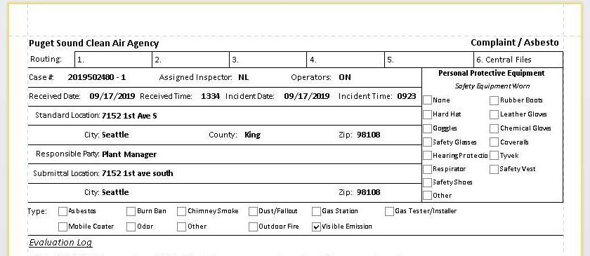
Complaint Evaluation & Prioritization
Example of a complaint:
Notes:
Interactive complaint investigation to work through with audience.

Slide 15
Complaint Investigation
Use the database to analyze data
Organize by zip codes, sources, type of complaint
Determine the best time to conduct an onsite investigation
Compare complainant submittal times with hours of operation
Notes:
Inspector only slides= Slide 14 – 19 (Change slide numbers) If someone is presenting this who is not part of the compliance department, this section should not be included in their presentation to the public/externally.

Slide 16
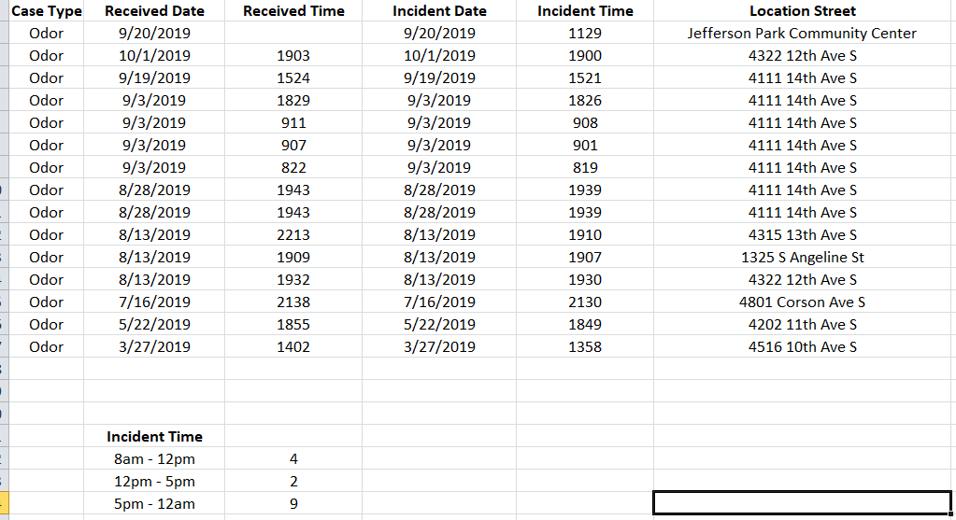
Complaint Investigation
Notes:
Nina: Do you have a better screenshot of this? Or can you take a screenshot of the whole spreadsheet and send to me so I can place and crop?
Example of complaint data analysis.

Slide 17
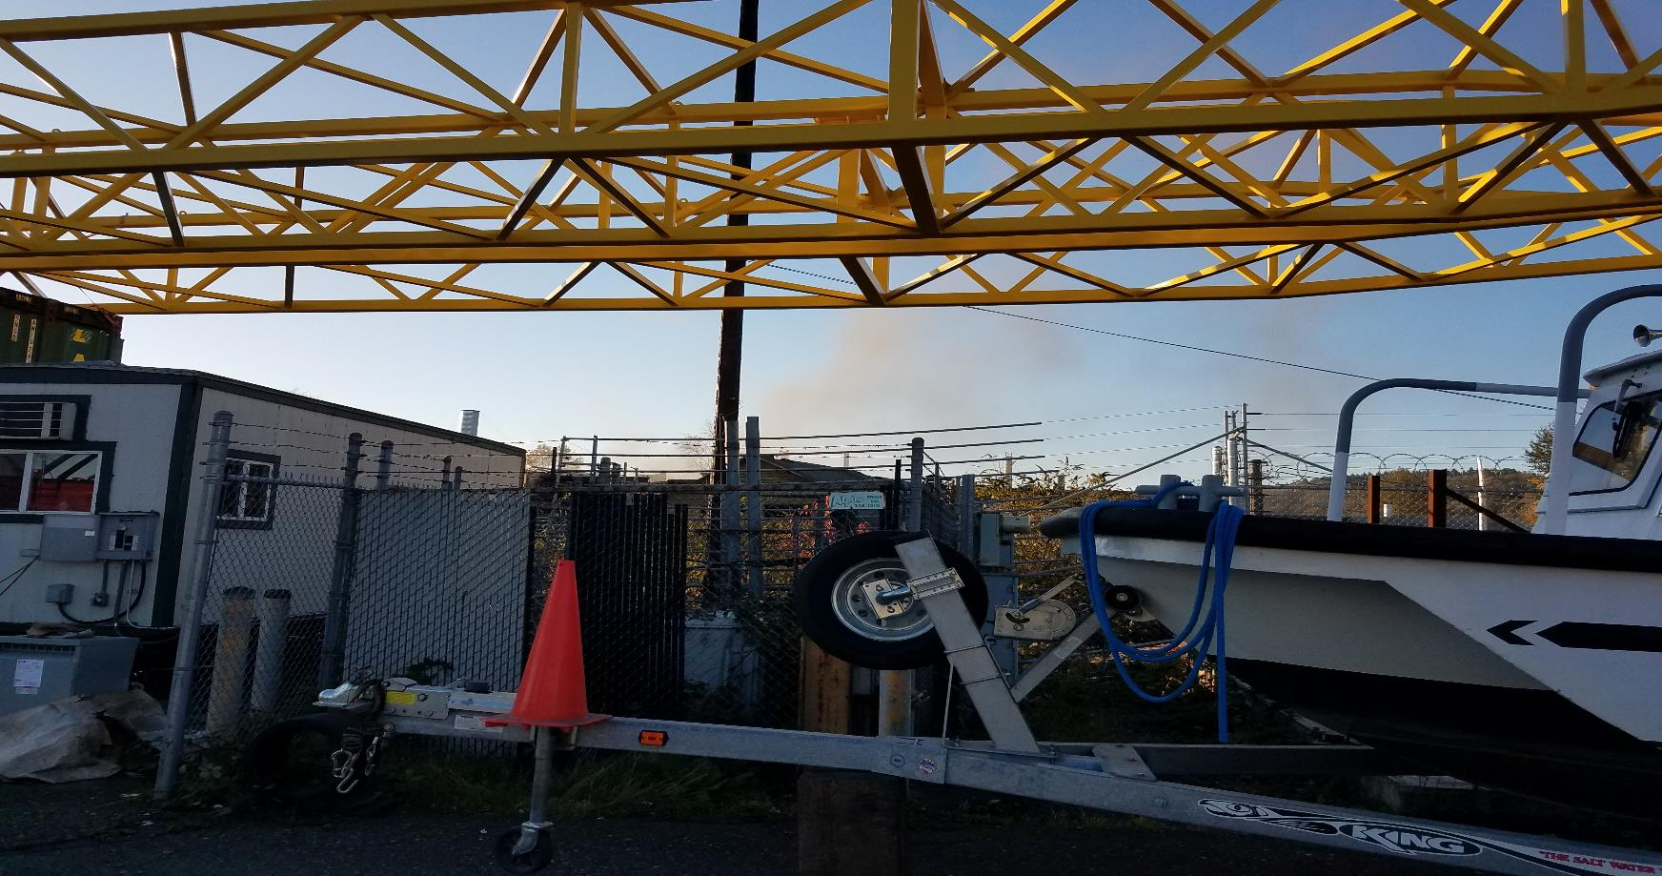
Example of Complaint Investigation
Notes:
Next in the complaint investigation example I will show the audience what I saw when I arrived onsite.
There is nothing identifying the source in this picture. I was given approval to use this photo as long as nothing identified the source.

Slide 18
Is It Fugitive Dust?
Notes:
Now that the amount of complaints received has been shown, data analysis, and onsite observation it is time to work through the potential applicable regulations with the audience. We start with Reg I 9.15 (explaining when it can be applied and that it was not applicable for this investigation).
Note: Reg I 9.15 is applicable to stationary and mobile sources.
PLEASE DO NOT READ WORD FOR WORD WHAT IS ON THE SLIDE

Slide 19
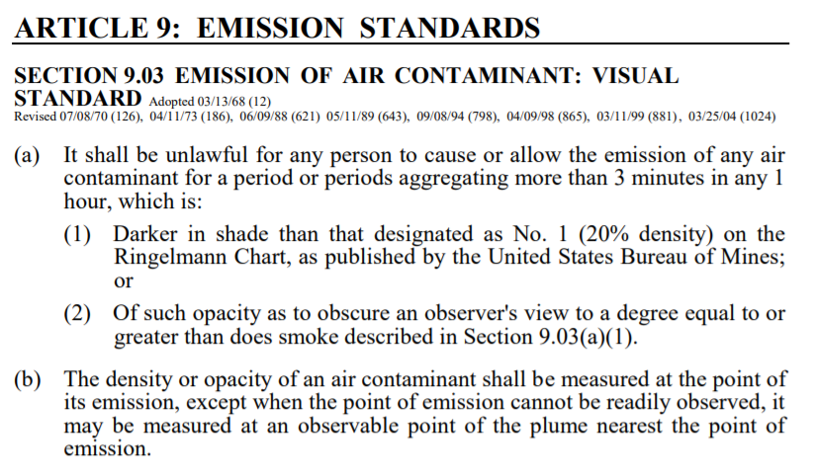
Notes:
Explain to the audience when Reg I 9.03 is used, and how it was not applicable for this complaint investigation. Again, we are ruling out potentially applicable regulations.
Not applicable because the source of emissions is not coming from a stack.
PLEASE DO NOT READ WORD FOR WORD WHAT IS ON THE SLIDE

Slide 20
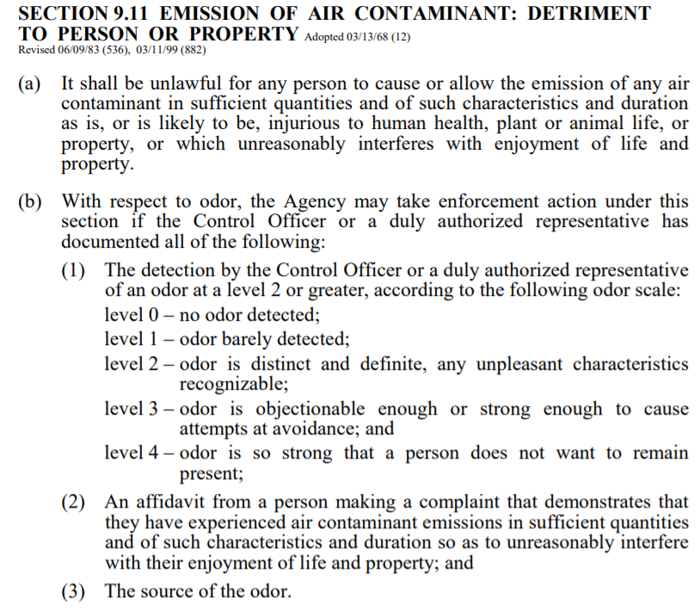
Notes:
Explain Reg I 9.11 and how it was used in this complaint investigation.
PLEASE DO NOT READ WORD FOR WORD WHAT IS ON THE SLIDE

Slide 21
Typical Agency Enforcement Process
Notice of Violation, Regulation I, Section 3.09; or
Civil Penalties, Regulation I, Section 3.11
Notes:
Enforcement timeline/process Inspection/Complaint, NOV, Mitigation,

Slide 22
Questions + Contact
Contact:
Online:
https://pscleanair.gov/262/File-a-Complaint
Phone: (800) 552-3565 Language services available
Mail: Puget Sound Clean Air Agency Attn: Inspection Department 1904 3rd Avenue Suite 105 Seattle, WA 98101
Notes:
Talking Point: Please offer a high level summary of the complaints process before opening the presentation up to questions.

