Slide 1
Marysville
Air Monitoring Study
Status Report
Notes:
1

Slide 2
Study Objectives
Assess Pm 2.5 conditions across Marysville
  Wood smoke
  Gradients and levels
  Determine conditions in Lake Stevens and N. Everett
  Evaluate relevance of the existing site

Slide 3
Study Area
Monitoring Sites
Totem M. S. (formerly Marysville Junior High) School (legacy site)
Marysville Pilchuck High School
Cedarcrest Elementary
Sunnyside Elementary
Lake Stevens Fire Station
Wiggums Hollow Park, North Everett

Slide 4
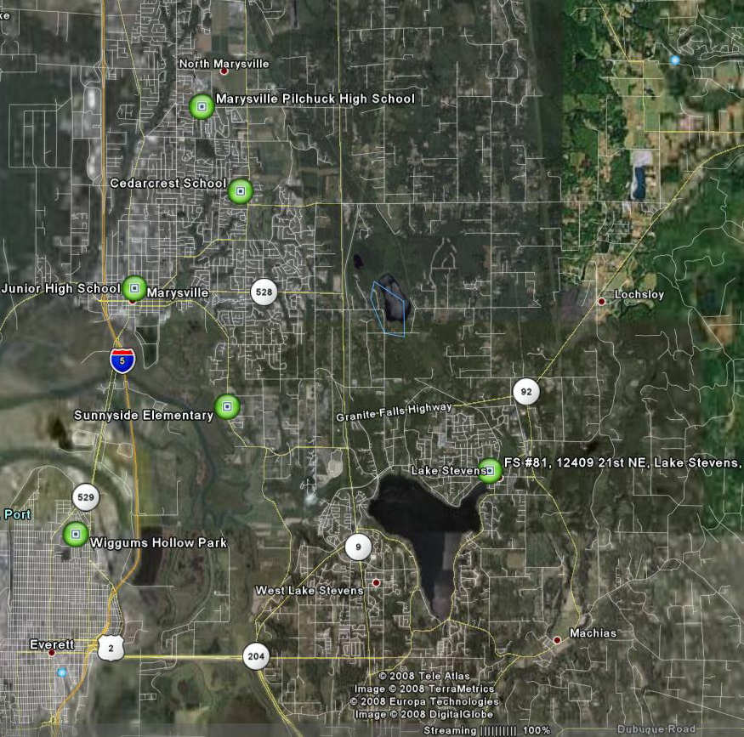
Study Area

Slide 5
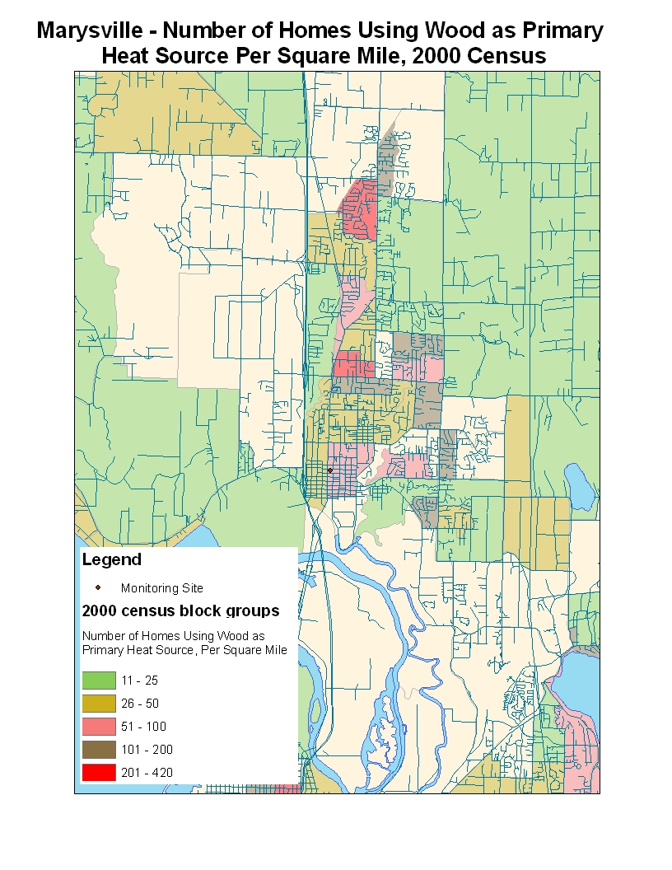
Marysville- Heating with Wood

Slide 6
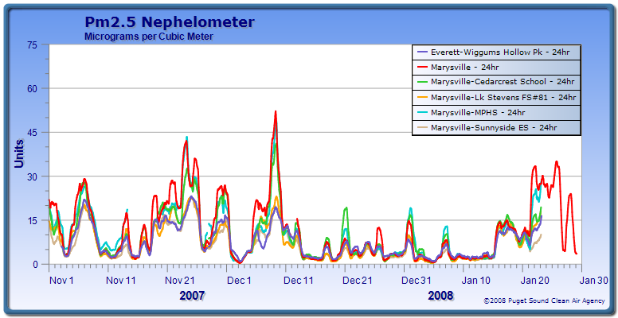
Results

Slide 7
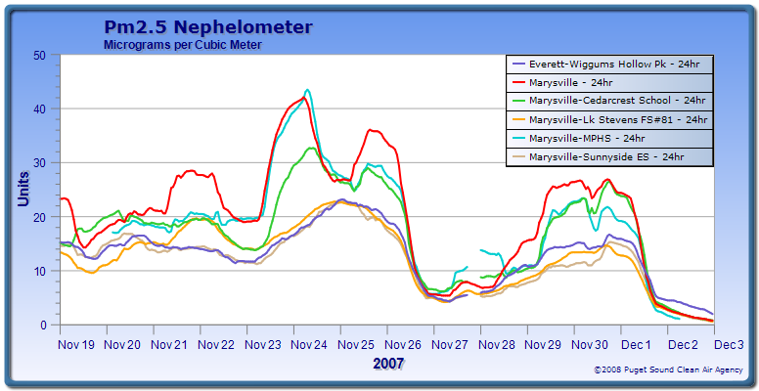
Results

Slide 8
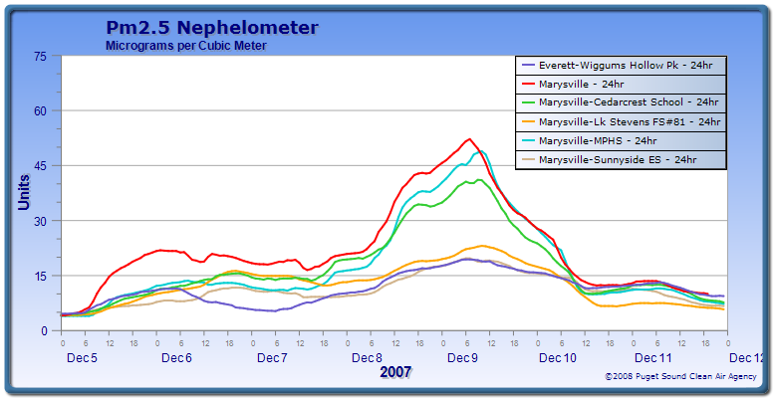
Results

Slide 9
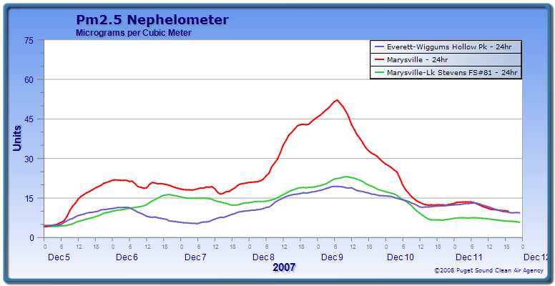
Results – Everett and Lake Stevens

Slide 10
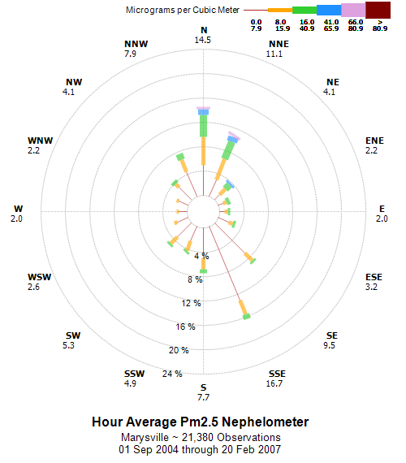
PM2.5 and Wind Direction-2004-2007

Slide 11
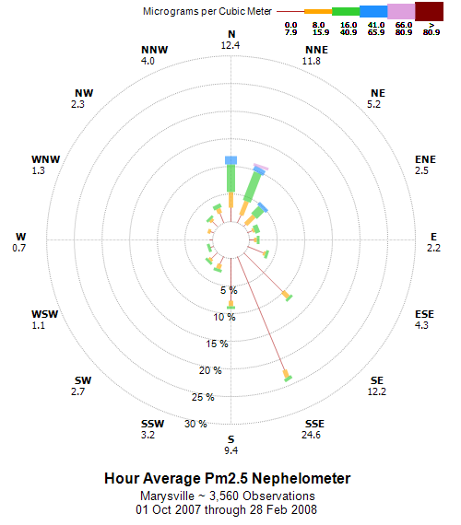
PM2.5 and Wind Direction- Study Period

Slide 12
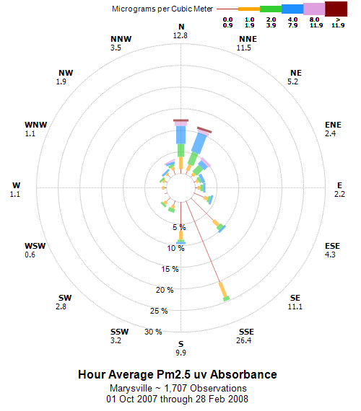
Wood Smoke Indicator- UV Absorbance

Slide 13
Conclusions
No unique meteorological features
Highest Pm 2.5 levels are in close proximity to the existing site
All sites south of the existing station show lower PM 2.5 concentrations
The existing site is suitable for characterizing PM 2.5 at the Neighborhood scale.

Slide 14
NAAQS Implications- 24 hr Standard
2 of the last 3 years have exceeded the NAAQS of 35ug/m3
Form of the standard averages last 3 years
Current levels are just over the NAAQS

Slide 15
NAAQS Relevance

Slide 16
Burn Bans
Dec 9-11, 2007 Stage One burn ban for King, Pierce, Snohomish Counties
Jan 23-26, 2008 Stage One burn ban for Pierce and Snohomish counties only

Slide 17
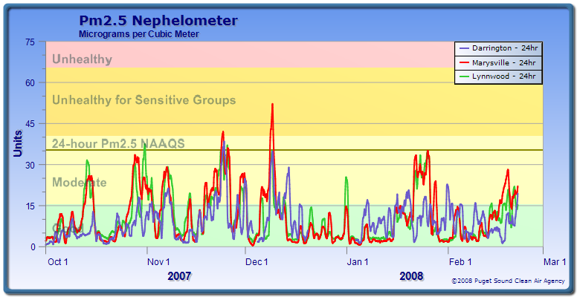
PM 2.5 Wood Heating Season
Snohomish County

Slide 18
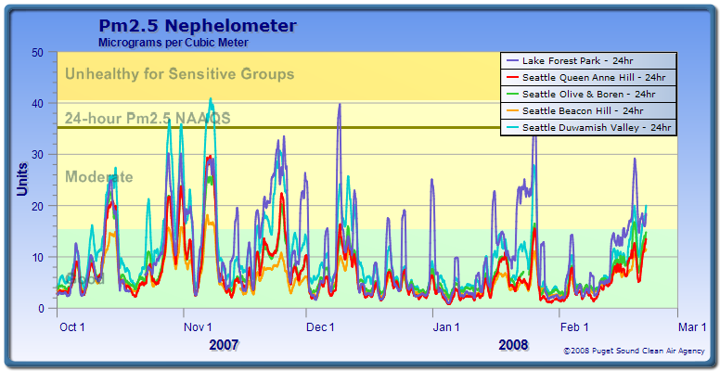
PM 2.5 Woood heating season
King County

Slide 19
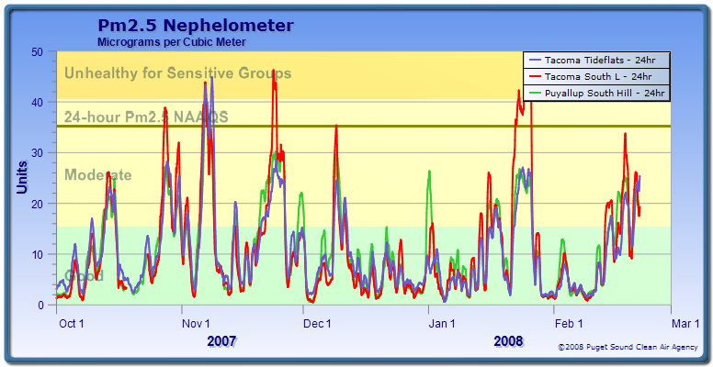
Pm 2.5 Wood Heating Season
Pierce County

Slide 20
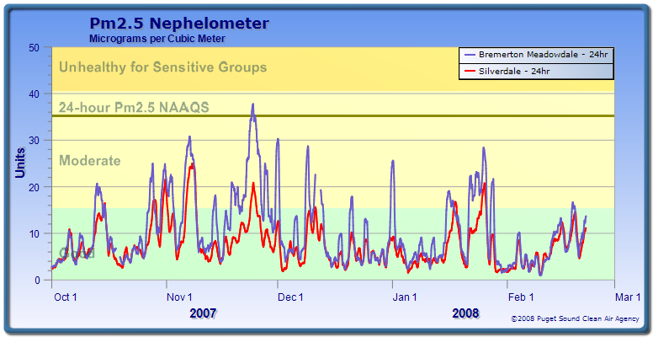
PM 2.5 Wood Heating Season
Kitsap County

Slide 21
Study Area

