Slide 1
Winter Air Quality study Air sensors north kitsap
March 28, 2019 PSCAA Board meeting Graeme Carvlin Matt Harper Air Monitoring Team
AIR QUALITY STUDY NORTH KITSAP

Slide 2
2014-2020 Strategic Plan Objective 1.5
Monitor in more places beyond our long-term trend network
“Characterize fine particle levels in at least 2 communities per county” by 2020
This year’s study covers 8 communities in Kitsap County
Notes:
2014, strategic plan was written

Slide 3
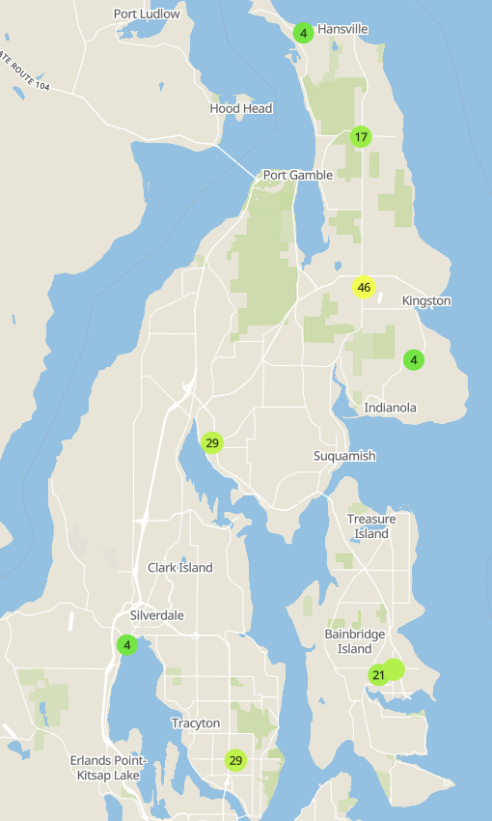
ABOUT
Hansville (Purple Air)
Little Boston (Purple Air and Ref Trailer)
Concern about communities with high levels of wood smoke
Pilot Purple Air Sensors at several locations
Data is available on web in real time
Provide useful hyper-local data
Spread designed to cover large geography
Partnered with North Kitsap Fire & Rescue and Kitsap Regional Library
Outreach to KRL customers is underway
Gamblewood (Purple Air)
Indianola (Purple Air)
Poulsbo (Purple Air)
Silverdale (Purple Air)
AIR QUALITY STUDY NORTH KITSAP
Bainbridge (Purple Air)
Bremerton (Purple Air and Reg Site)
Notes:
Partnered with North Kitsap Fire & Rescue
-Established four sensor locations
-Located on the fire station buildings
-Uses outdoor electrical receptacle
-Uses Fire Dept WiFi to transmit data
-Started first week of October
Mobile monitoring in the past – nephs, etc.
Partnered with Kitsap Regional Library
-Established agreement to use up to six
-Very similar setup to NKFR
-Uses existing electrical and WiFi
-Outreach to KRL customers is underway
Used Purple Air Sensors at several locations
-Data is available on a website in real time
-Sensors are small
-Sensors accuracy and precision evaluated
-Provide useful hyper-local data
Spread designed to cover large geography

Slide 4
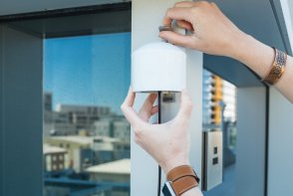
Purple Air Sensor
Low-cost, $250
Power, Wi-Fi
Require calibration
AIR QUALITY STUDY NORTH KITSAP
Notes:
Read 2-3x high
We filled in the gap in Kitsap (were none, now one in Bainbridge)
People buying but geographic conc.

Slide 5
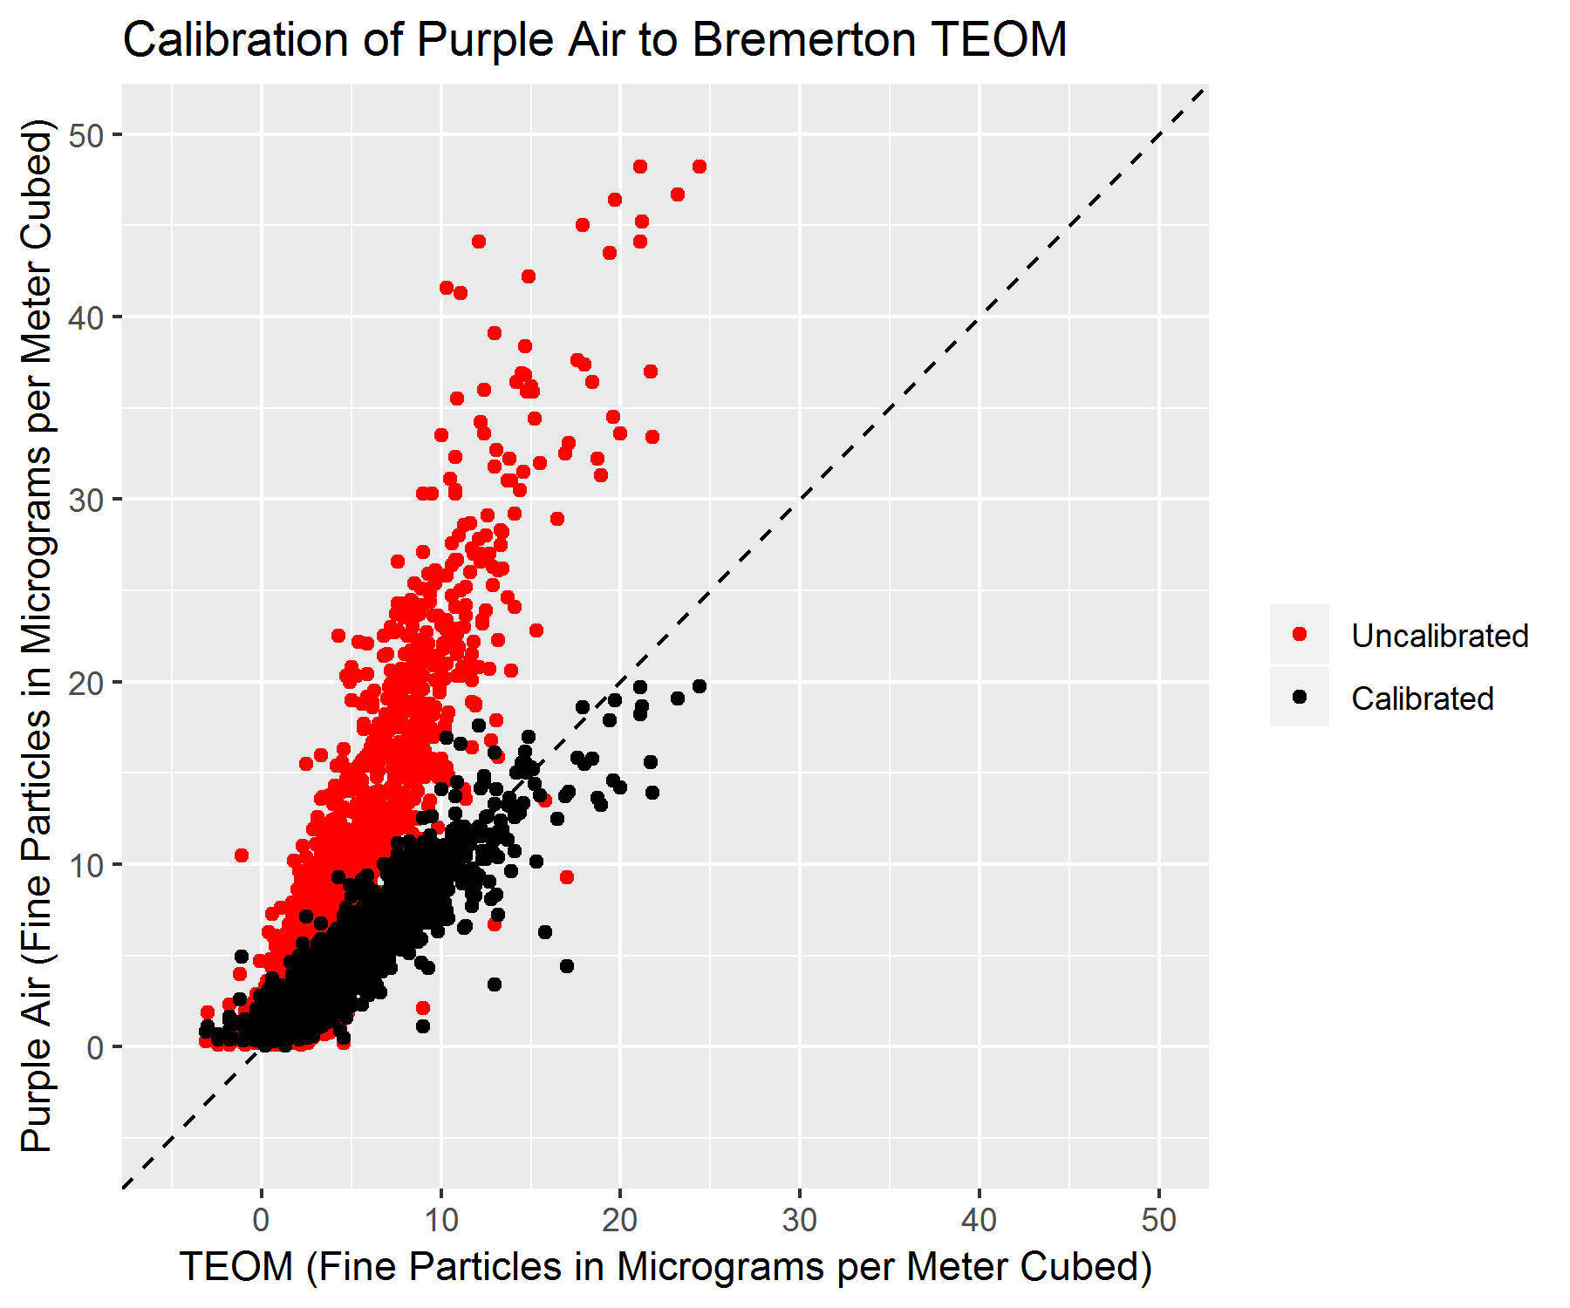
Before calibration, Purple Air reads 2.5x higher than reference
Calibration bring the Purple Air readings much closer to reference

Slide 6
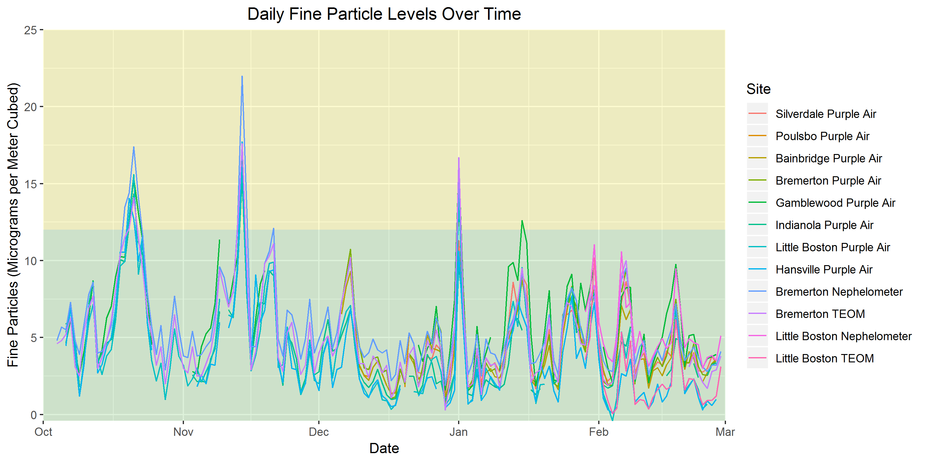

Slide 7
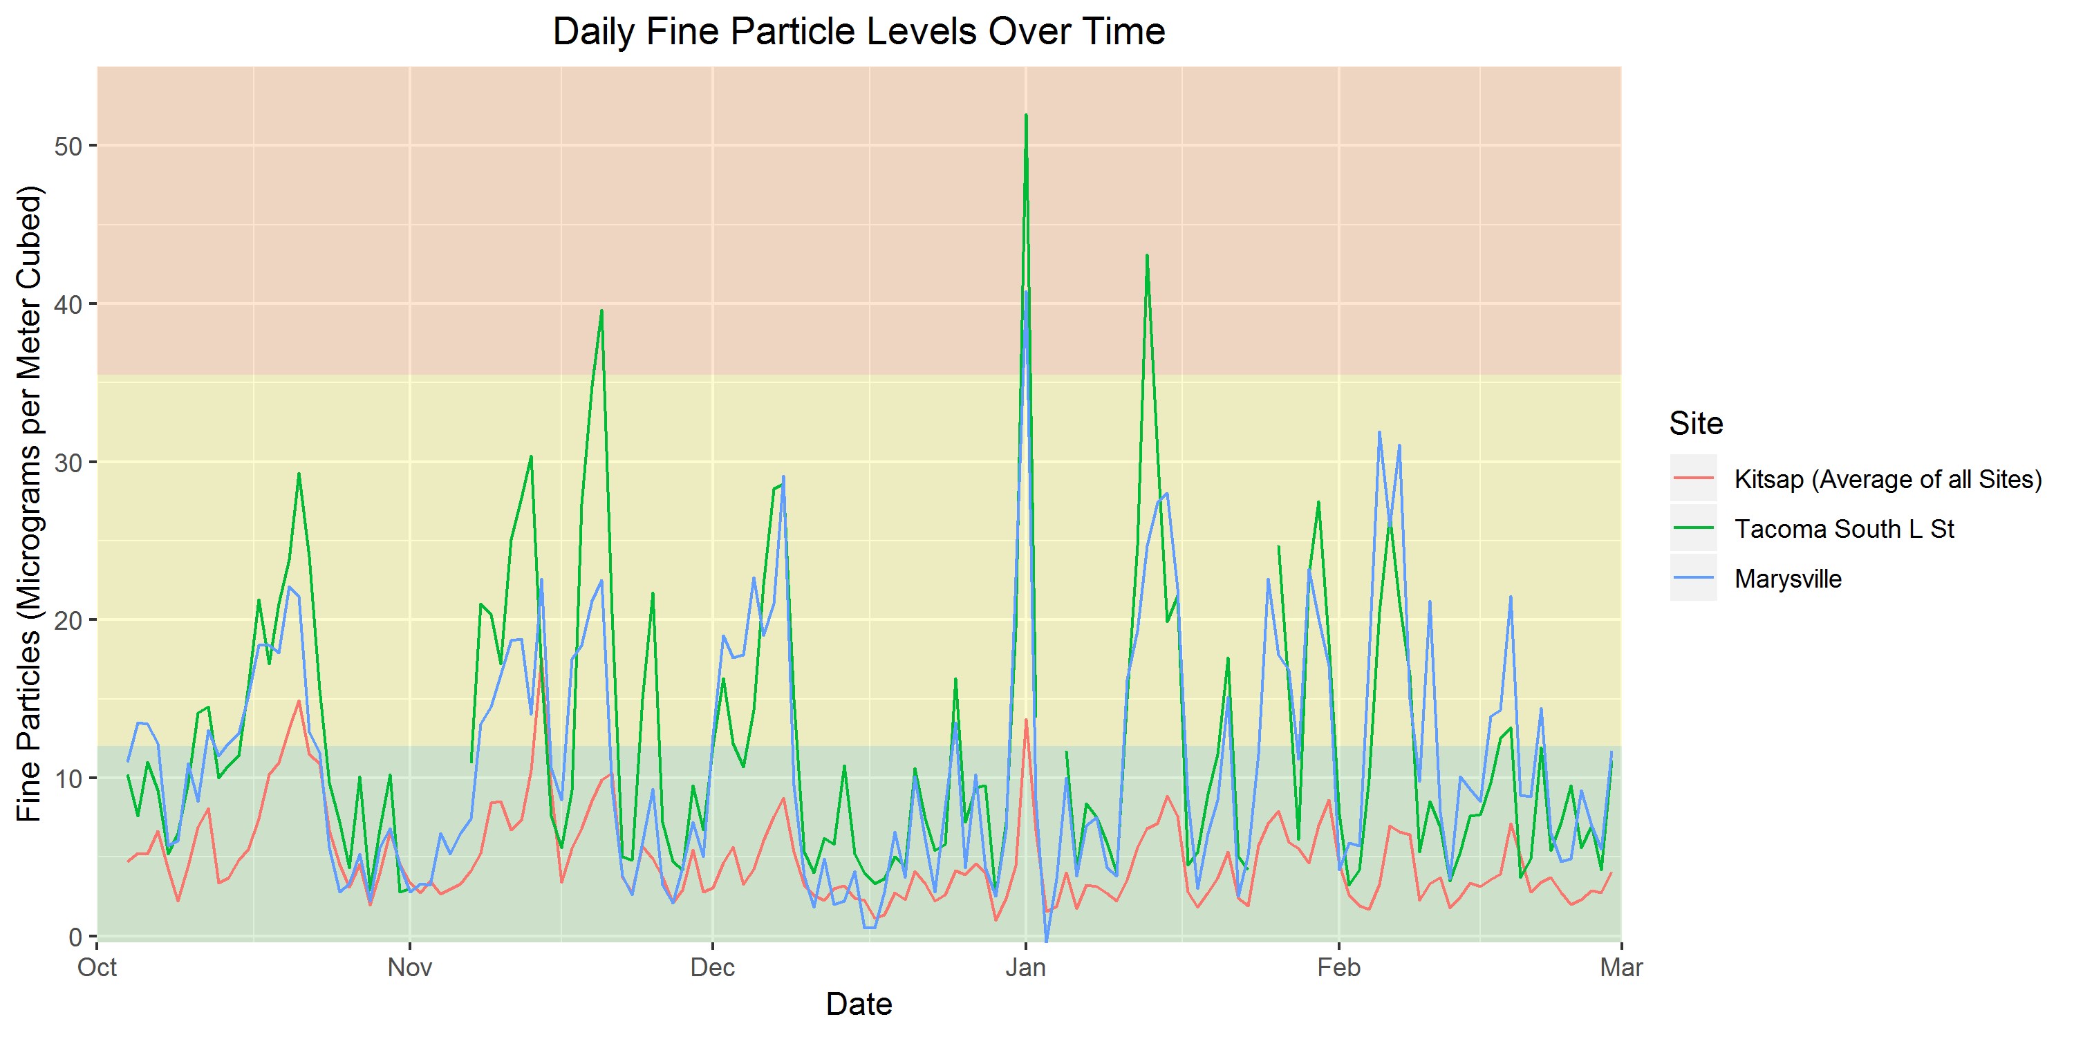
Notes:
Different meteorology (more wind over the Sound)

Slide 8
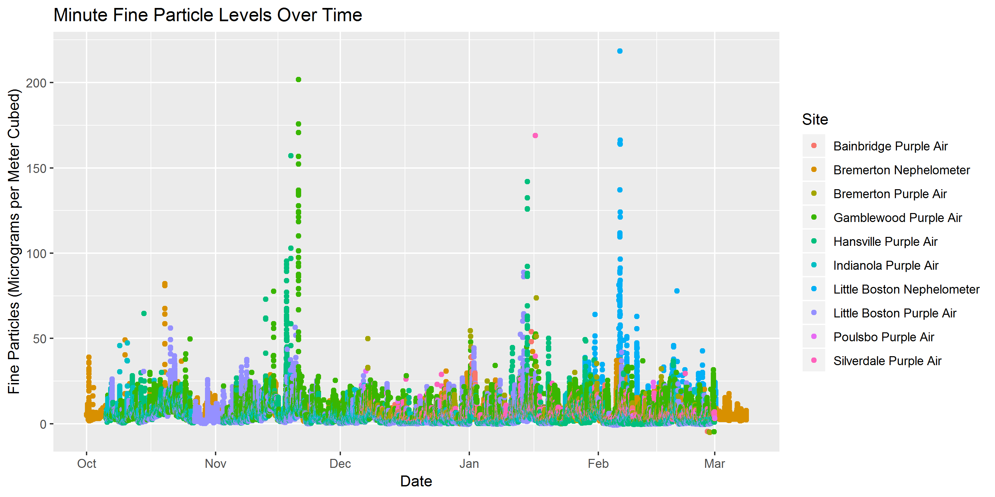
Gamblewood
Purple Air
Bremerton Neph
Hansville
Little BostonNeph
Purple Air
Little Boston
Purple Air

Slide 9
Preliminary Observations
This winter, Kitsap County met our air quality health goal
Short term spikes in fine particles occurred at some sites
People living next to wood burning households may experience poorer air quality (micro scale impacts)
Notes:
No day over 25 micrograms per meter cubed (EPA is 35)
There are health studies that show impacts under the standard
Wood burners might have poorer air quality

Slide 10
EXTRA SLIDES

Slide 11
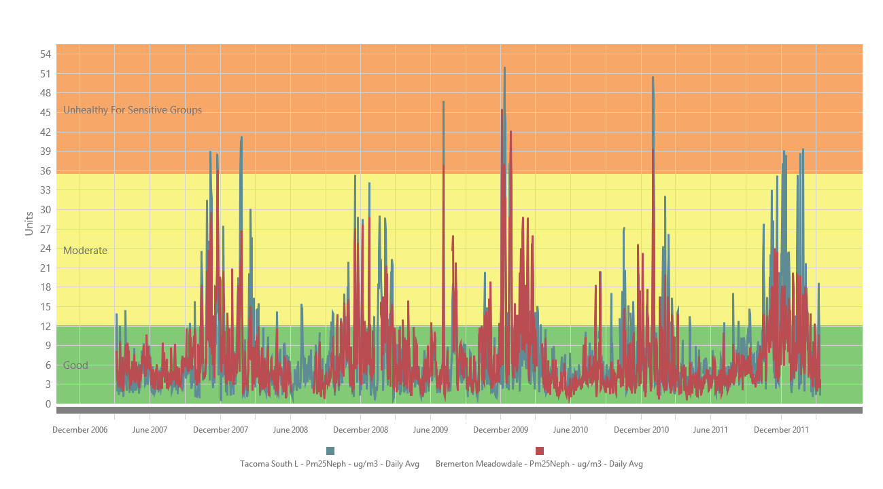

Slide 12
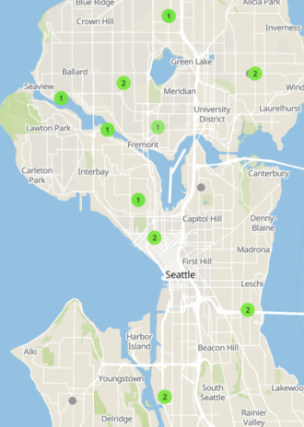
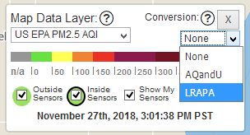
HOW TO USE THE PURPLE AIR WEBSITE
https://www.purpleair.com/map#11.1/
Click on “Conversion” from the drop down menu:
Select “LRAPA” to get the correct relationship for our region
Otherwise, the values are twice as high as the reality
http://www.pscleanair.org/539/Air-Quality-Sensors
AIR QUALITY STUDY
NORTH KITSAP

Slide 13
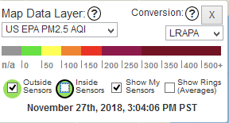
HOW TO USE THE PURPLE AIR WEBSITE
Uncheck the “Inside Sensors” box to see only outdoor air monitors:
AIR QUALITY STUDY
NORTH KITSAP

Slide 14
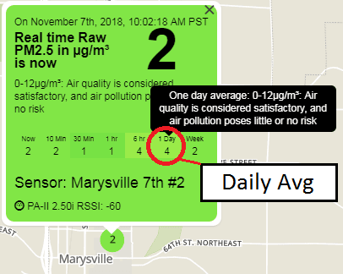
HOW TO USE THE PURPLE AIR WEBSITE
Click on the site you want to look at
Since the AQI is only good for a full day of measurements, you should look at the “1 Day” average (the second from the right)
AIR QUALITY STUDY
NORTH KITSAP

